Slide 1
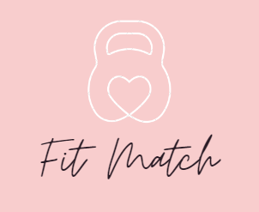
Fit Match
The application that match fitness and diet plan to your constraint
Andrea Panceri, Francesco Sudoso, Pietro Lamanna

Slide 2
IDEA
The main goal of FitMatch is to provide a list of personalized workouts and diets that have been selected based on the user's specific needs.
As the user progresses in their fitness journey and achieves their goals, the app will adjust their workouts and diets accordingly to continue to challenge and support them.
FitMatch is the ideal application for anyone looking for a simple and personalized way to improve their health and fitness, without wasting time in organizing training days and meals to be eaten during the day.

Slide 3
Competitors

Slide 4
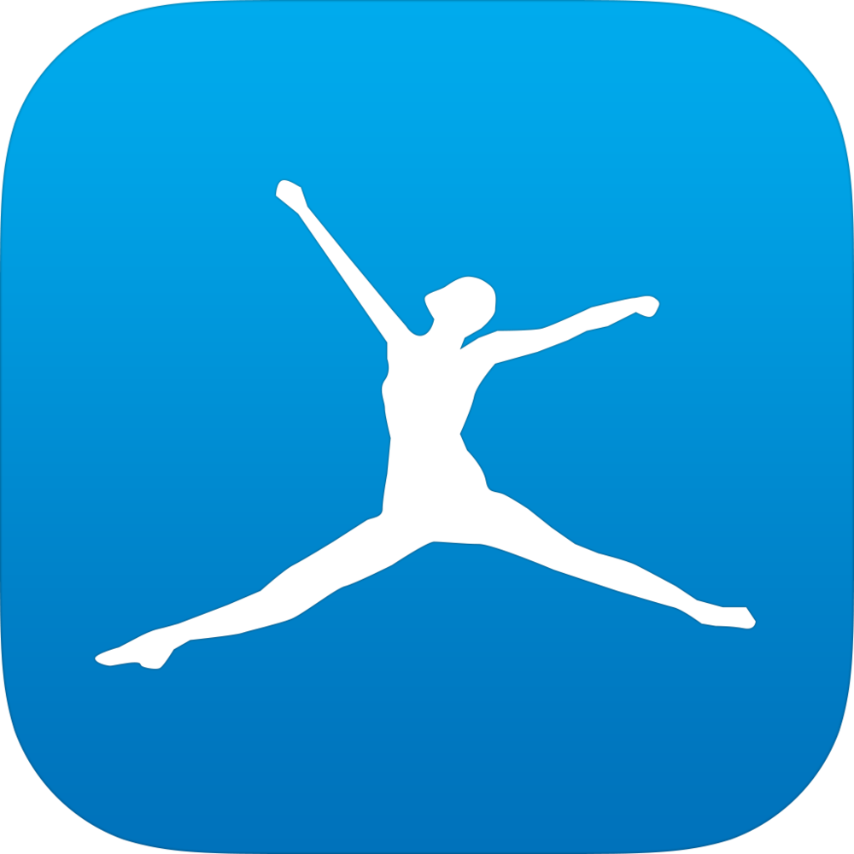
MyFitnessPal
Popular app that allows users to track their daily food intake and exercise
Has a large database of over 11 million foods, making it easy for users to find and log their meals.
Has an active community of users who can offer support and advice to one another.
Can integrate with other apps and devices, such as fitness trackers and smart scales, to help users track their progress.
Some users have reported inaccuracies in MyFitnessPal's calorie counts for certain foods, which can lead to overeating or undereating.
Tracking every meal and snack can be time-consuming and may be difficult to maintain in the long term.
Some features, such as tracking macronutrients and accessing certain recipes, require a paid subscription.
Having a large database with specifications of all kinds of common foods is a good idea.

Slide 5

FitBit
Popular app that allows users to track their daily food intake, exercise, and weight.
Fitbit devices use advanced sensors to accurately track their health metrics.
Has an active community of users who can offer support and advice to one another.
Has an active community of users who can offer support and advice to one another.
Fitbit can send users reminders to move, drink water, and take breaks.
Fitbit devices can be expensive, and some features require a paid subscription.
Tracking every meal and snack can be time-consuming and may be difficult to maintain in the long term.
Some features, such as tracking macronutrients and accessing certain recipes, require a paid subscription.
Active community of users who can offer support and advice is a good idea. Also integrating data obtained from trackers is very useful.

Slide 6

MMA Spartan
Fitness app designed for martial arts enthusiasts and individuals looking to get in shape
A wide range of workouts that target various muscle groups and aspects.
Hundreds of exercises that focus on strength, flexibility, speed, and endurance.
Workout routines matched user fitness levels.
Bodyweight workout app without needing any equipment or gym membership.
Some exercises in the app may not come with detailed instructions, which could lead to improper form and potential injury.
Does not offer any live support or feedback from a personal trainer.
Exercises that do not require the use of equipment or a gym is a good idea.

Slide 7

7 Minute Workout
Fitness app that offers high-intensity interval training (HIIT) workouts that can be completed in just seven minutes.
The workouts are designed to be completed in just seven minutes.
No equipment needed.
The workouts cannot be customized.
The app does not offer any guidance or support from a personal trainer.
Limited number of exercises.
Workouts that take 7 minutes to complete is a good idea for people who do not want to devote too much time to training.

Slide 8
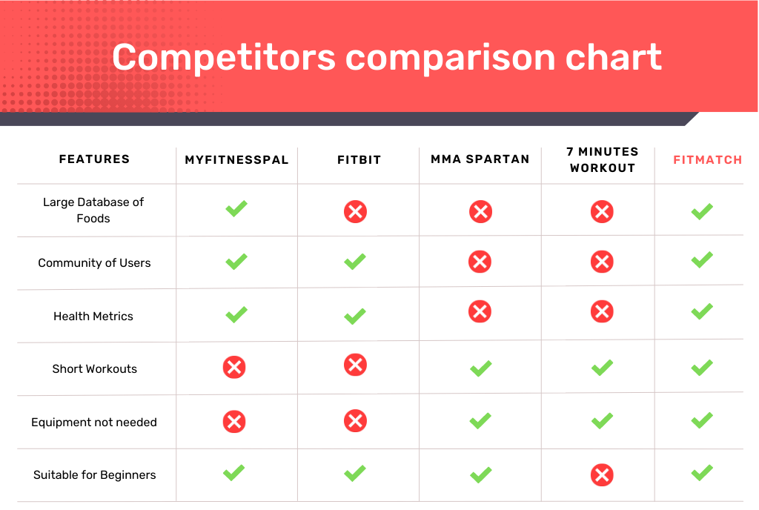
To summarize:

Slide 9
User profile, personas and scenarios

Slide 10
User Profile:
Age | 14-50 years
Gender | Male/Female
Medical Conditions | Diabetes, High blood pressure, Asthma, etc.
Employment | Student, Worker, etc.
Location | Worldwide
Technology | Compatible with both iOS and Android devices, requires internet connectivity, and access to GPS, also compatible with smartwatch.
Accessibility | The app should be designed to be accessible to individuals with disabilities or specific limitations.

Slide 11

Persona
Scenario
Maria is a 25-year-old software developer who recently started her first job after graduating from university.
She is engaged and has been living with her boyfriend for 2 years. In lonely moments she likes to paint, and on weekends, when she does not have to work, she enjoys volunteering at a local charity. These activities are a source of joy and fulfillment for her, as well as a way to express herself creatively.
She would like to start doing sports to have a more active and exciting day, since he often works from home. Also, being an extrovert, sports would be an opportunity to socialize with people and share her time with them. She wants to establish a healthy routine that fits her schedule and helps her feel more energized throughout the day.
On a bright summer morning, Maria wakes up early, stretches, and looks out the window. She takes a deep breath of the fresh air and she realizes that she feels a bit contracted and with little mobility of the body.
Nevertheless, he prefers not to worry about it at this time and decides to go to work. While having a conference, she realizes that her neck has contracted and she cannot turn it. At this point she realized that it is necessary to find a solution to the problem.
In the afternoon, after work, she decides to call a friend of hers, Greta, to ask her advice, since she is a professional athlete in artistic gymnastics. Greta, after understanding her problem, recommends the app she also uses, namely FitMatch, explaining to her that it will allow her to get a workout plan customized for her and a diet that fits her goal.

Slide 12

Persona
Scenario
Diego is a 32-year-old freelance writer who works from home. He enjoys the freedom of being his own boss and setting his own schedule, but he finds it difficult to maintain a healthy lifestyle.
He is a creative person, and his work succeeds in fully satisfying his desire for expression.
In his free time, he usually tends to take very long walks to be inspired by his surroundings. He also has a tendency to snack on junk food while working, which has resulted in weight gain and low energy levels. Diego wants to establish healthy eating habits and incorporate regular exercise into his routine.
It's Monday morning and Diego is feeling guilty after a weekend of overeating and not exercising.
He decides to take control of his health and after searching on the Internet something that can help him with his problem, he finds the FitMatch app being recommended by people in a gym forum.
So he downloads the app and after setting up his profile and goals, Diego begins using the app to track his meals and exercise.
At lunchtime, Diego is tempted to grab fast food with his coworkers, but he pulls out his phone and opens the app. He finds healthy restaurant options nearby and selects a meal that fits his calorie and nutrition goals.
After work, Diego heads to the gym. He uses the app to track his workout, which includes a mix of cardio and strength training.

Slide 13

Persona
Scenario
Marcus is a 35-year-old guy who lives in the United States. Born and raised in Detroit, Michigan, Marcus is currently a software engineer working for a tech startup in Silicon Valley.
Growing up in a city known for its automotive industry, Marcus developed a fascination with cars and mechanics. This passion for problem-solving eventually led him to pursue a degree in Computer Science.
In his free time, Marcus enjoys listening to hip-hop music, watching basketball games, and playing video games with his friends.
He also volunteers at a local community center, where he mentors young students and helps them develop their skills in STEM fields.
It's a beautiful Saturday morning and Marcus is planning to go for a hike with some friends. However, he is a little nervous because he hasn't been very active lately and is worried about keeping up.
His friend advises him to download the FitMatch app, telling him that it provides tutorials and workout plans, even for beginners.
In the afternoon, Marcus, after downloading the app, finds a workout plan that focuses on building endurance and stamina and decides to follow it to get ready for the hike.
On the day of the hike, Marcus is excited and a little nervous. He feels strong and energized thanks to the training he has done with the app.
As Marcus heads home, he reflects on how far he has come and feels proud of himself for taking control of his health and fitness.

Slide 14
Questionnaire

Slide 15
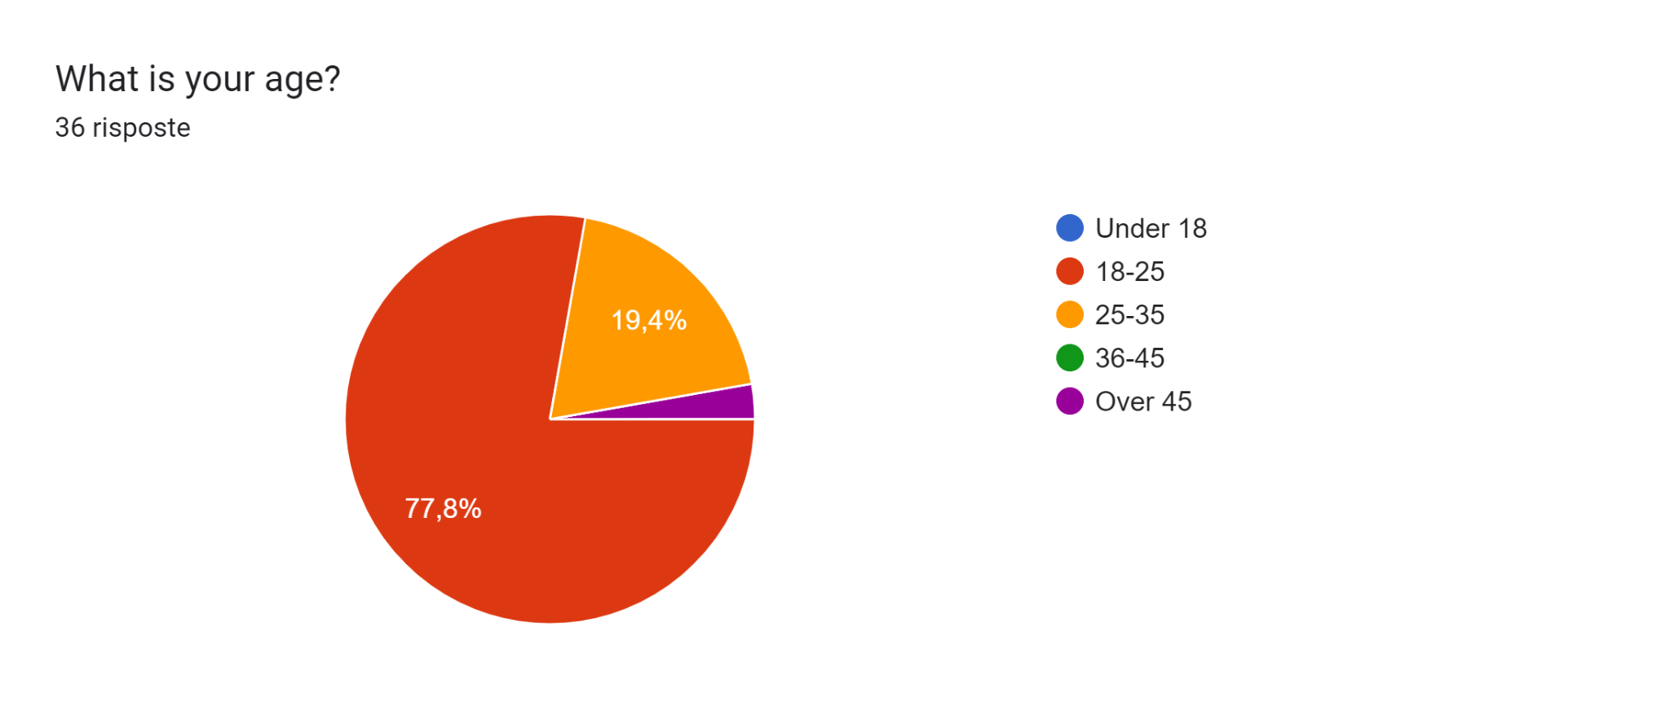
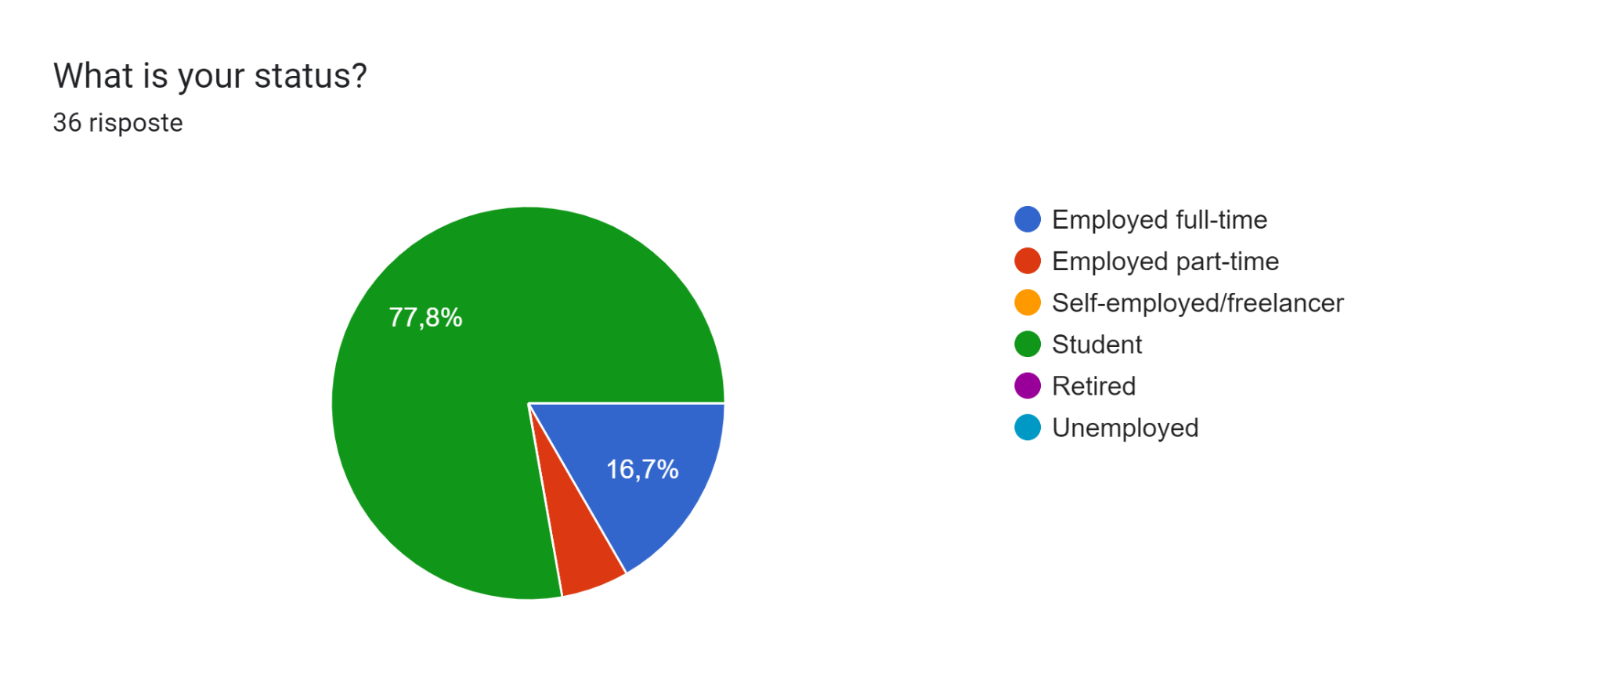
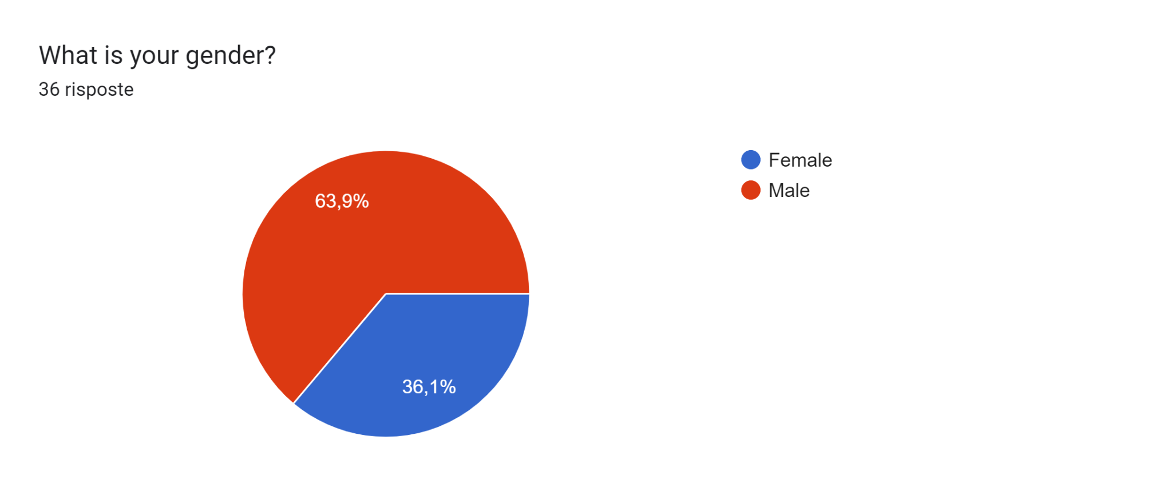
It is important to emphasize that the questionnaires were submitted mostly to students.
For this reason, some questions may present results that are polarized toward a single answer.
User’s general info

Slide 16
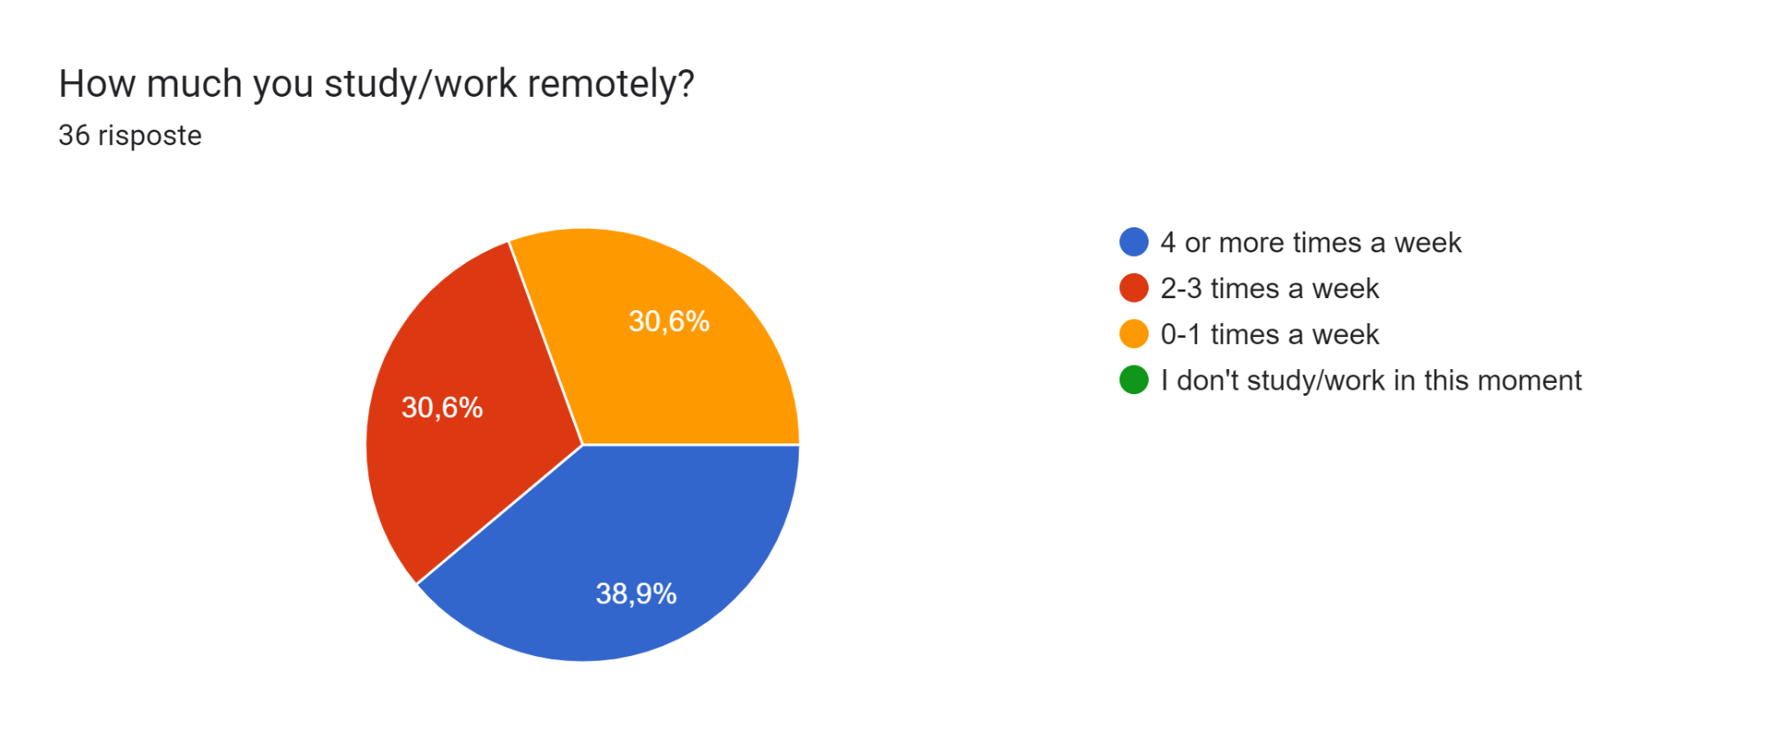
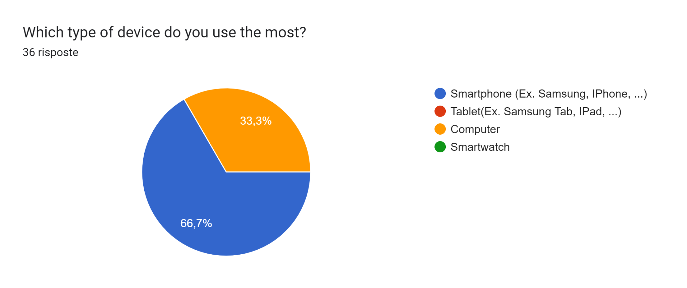
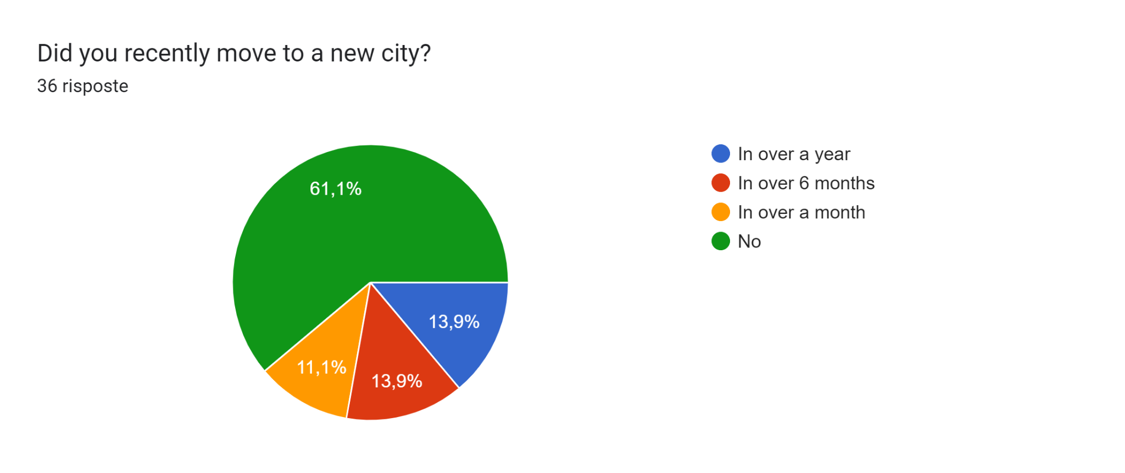
User’s general info

Slide 17
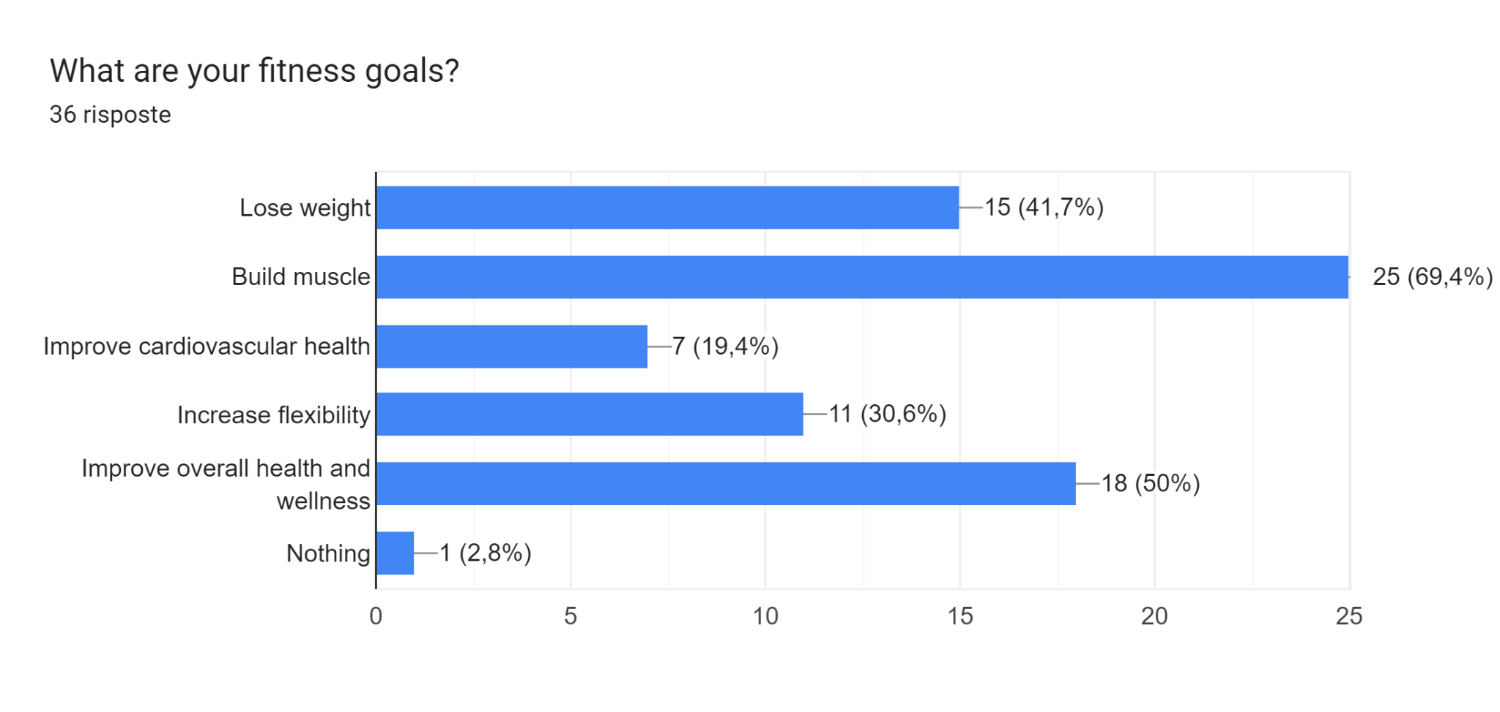
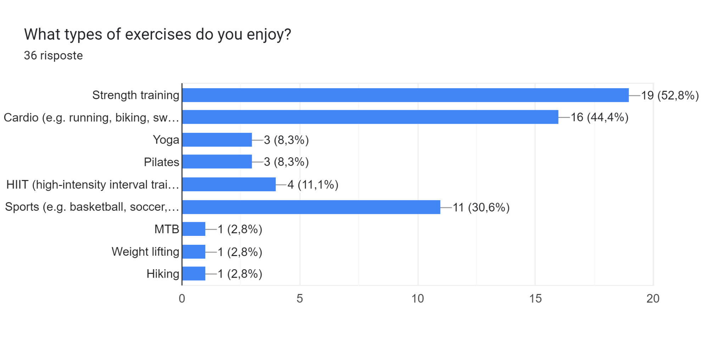
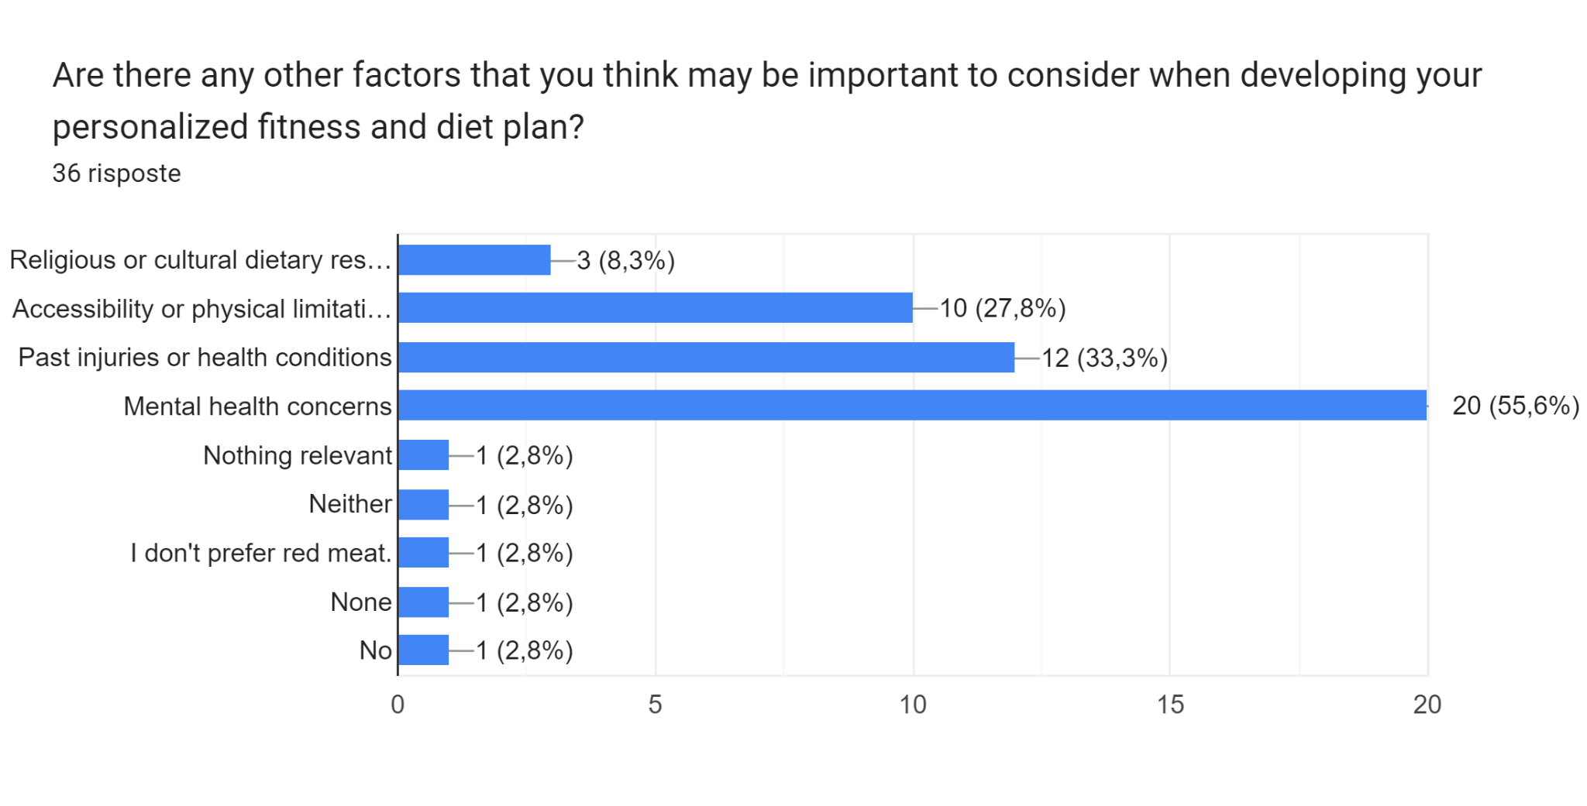
Validation of the idea

Slide 18
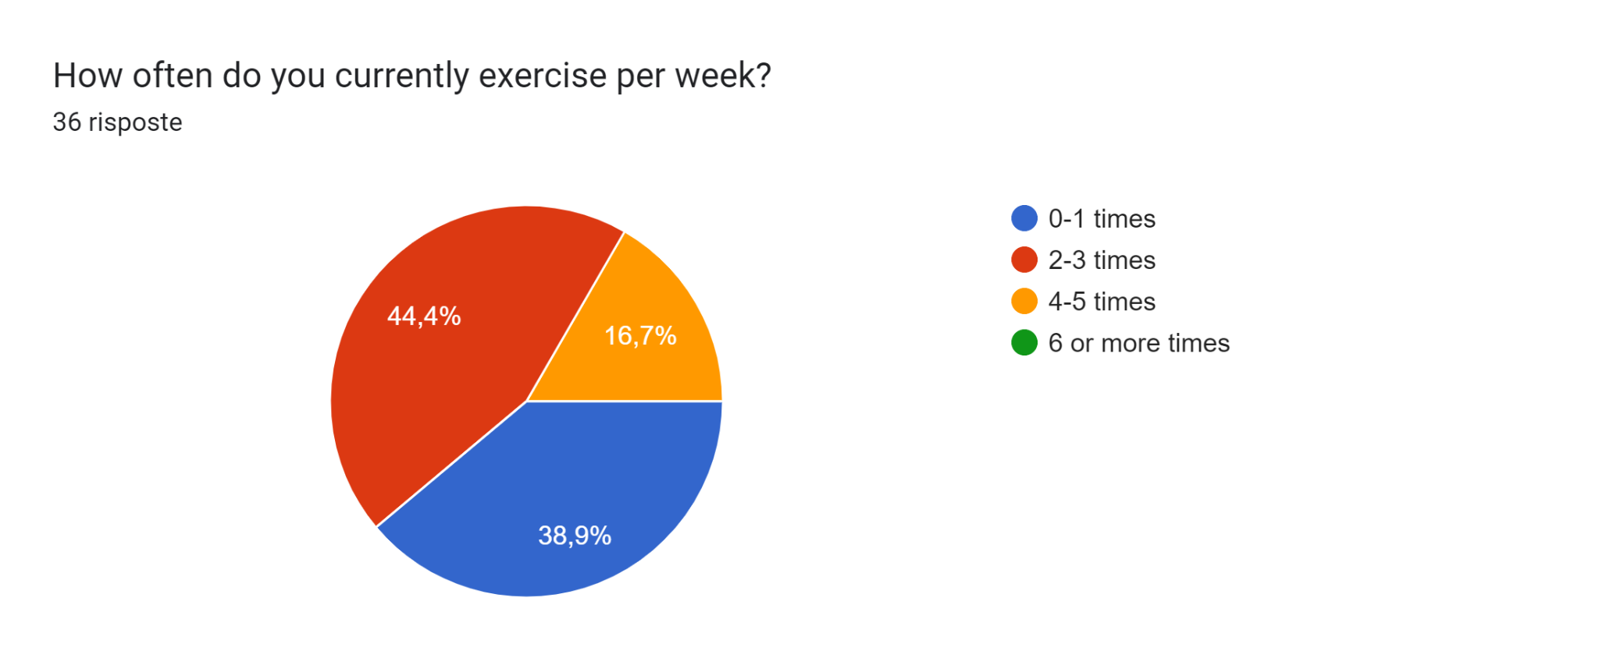
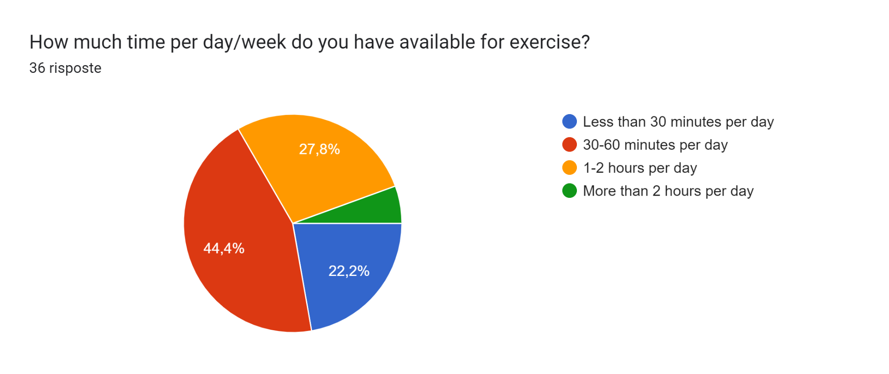

Validation of the idea

Slide 19
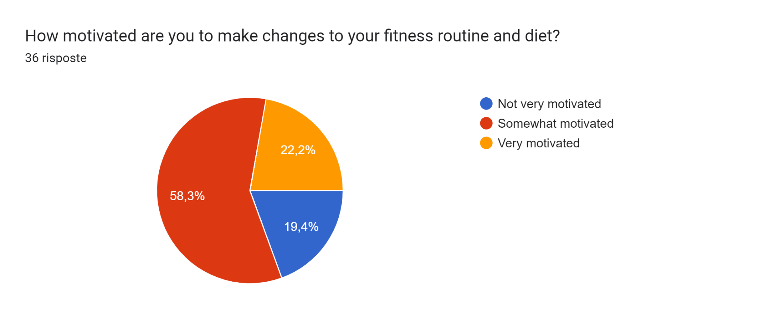
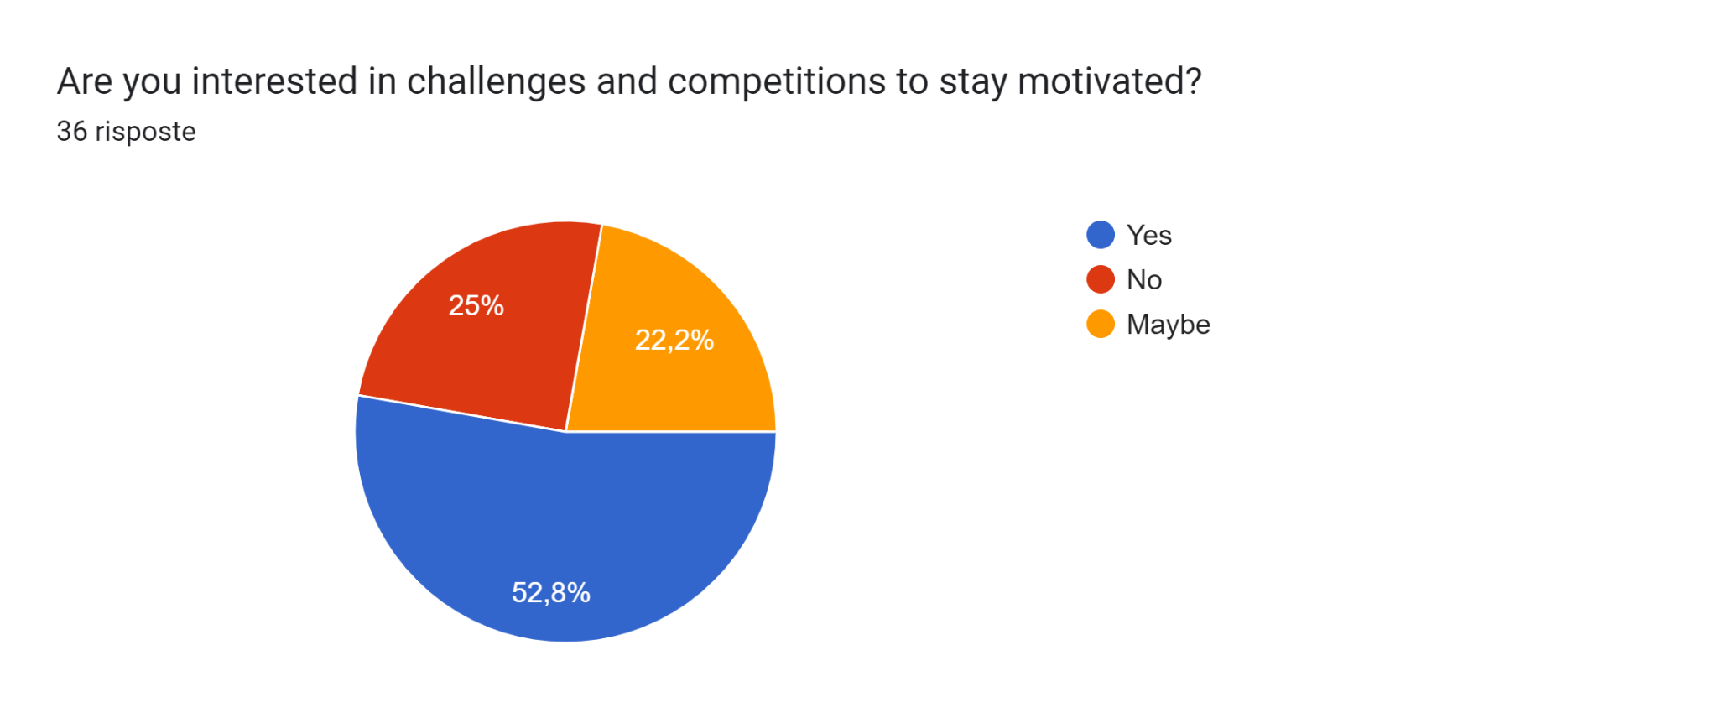
Validation of the idea

Slide 20
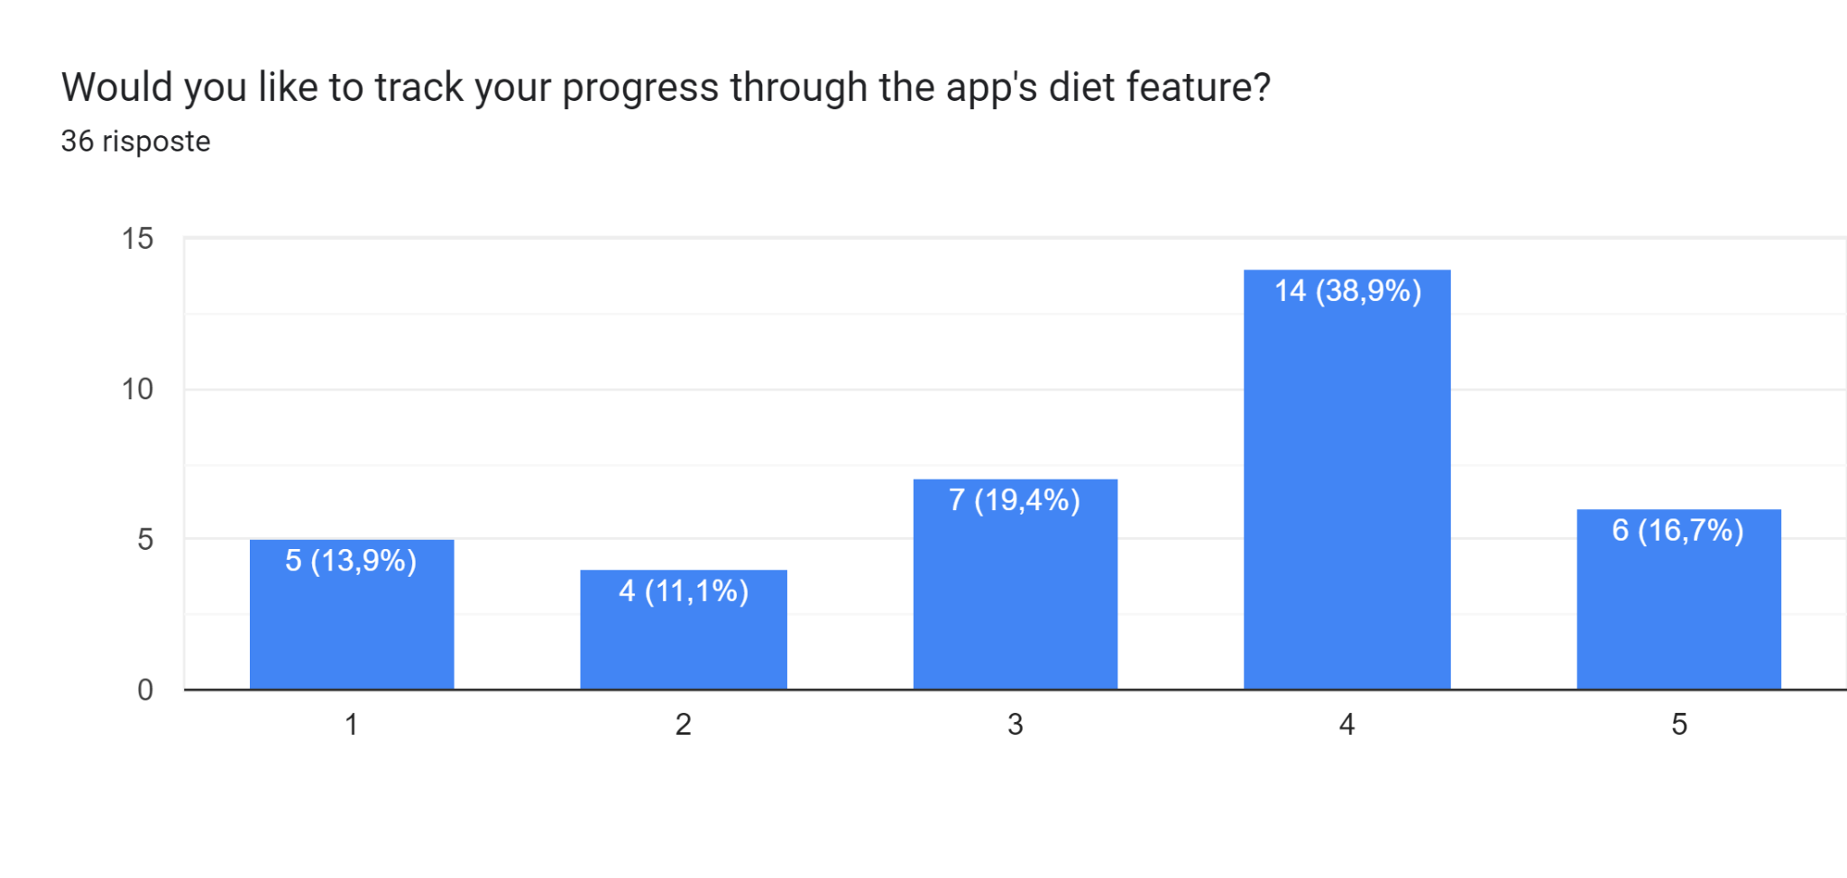
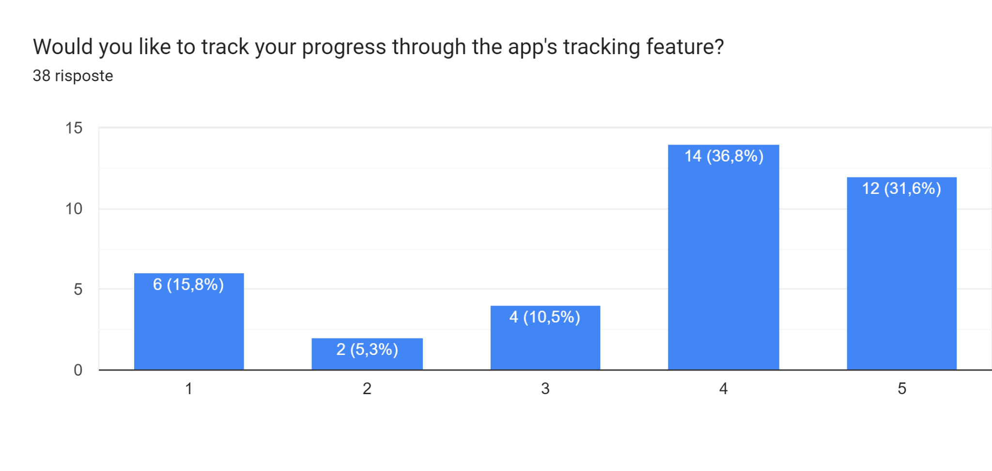
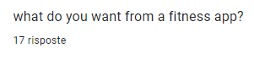
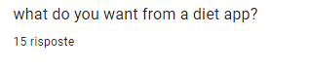
Usefulness and collecting opinions

Slide 21
About 60% of possible customers are male users, against the 40% of women. There is no specific target related to the user's gender. We can confirm the idea of building gender-based training paths.
The age of our customers ranges from 18 to over 45. Most of them are in the 18-25 range. Depending on age, we can identify lighter training exercises.
About 80% of respondents are students, with a lower concentration of full-time workers. Our application will make sure to calibrate the training according to the user's free time.
The most used device is the smartphone. For this reason we will develop the mobile application.
The goals of our possible customers are mainly to build muscle and improve overall health. The main field of our application is diet and training.
About 40% of respondents enjoy cardio and strength training. The users will be able to choose the type of training.
Most of the possible users have 30 to 60 minutes to be able to train. For this reason, both short and long training plans will be proposed.
There is an equal partition between users who are beginners and users who are moderately trained. Our app will distinguish training routes based on their physical level.
There is a high interest in tracking individual users' progress. It will be a feature of our app.
Conclusion of Questionnaires

Slide 22
Interviews

Slide 23
Simone:
26 years old
Born in Rome, Italy
Live in Milan
15 minutes unstructured interview
Simone told us about the main difficulties that he had to face eat less and go to the gym. He has always been interested in staying active and eating healthy, and used to play soccer in high school and university.
Advices:
Having a feature for tracking the progress of the workouts and diet could keep them motivated
Continuously updated diet and training plan depending on progress would allow faster results
Functionality to find people or groups near you to train together would make the experience more enjoyable
Approval: Simone is very enthusiastic of our idea

Slide 24
Federica:
32 years old
Born in Rome, Italy
Live in Rome
15 minutes unstructured interview
Federica is focused on exercise and diet, but has difficulty maintaining consistency. She used to practice dance in high school, but after the birth of her son, she no longer has time to stay in fitness.
Advices:
Provide personalized recommendations based on preferences and goals of the person
Dynamically redefine the diet in case of intake of foods not included in the diet
Showing a recipe for a dish would make it easier to follow the diet
Approval: Federica has enjoyed our project and she will follow the next update

Slide 25
Francesco:
25 years old
Born in Bari, Italy
Live in Rome
15 minutes unstructured interview
Francesco told us about his interest in staying healthy. He tries to avoid junk foods and used to go jogging with his ex-girlfriend. After he broke up, he lost this habit and gained weight.
Advices:
Introducing diets with quick and easy meals would make it easy to follow the plan for people who cannot cook
Consider training plans that do not have to be performed in the gym
Inserting achievable goals would motivate people to continue the diet and workout
Approval: Francesco say that this idea has a lot of potential

Slide 26
We notice a common problem in finding a workout plan to follow for a long time, in that the application must provide various plans based on preference and time available by the user. Also must change regularly the exercise like to always maintain motivated the user.
Another problem is to find an easy recipe to cook and follow a healthy diet, must provide in application an easy recipe that can be done in a short time and low number of ingredients.
All interviewers are interested in fitness and diet, which confirm the result of the questionnaire.
Working with other people can help to stay motivated and focused.
Tracking progress and set goals can be useful.
Personalized workouts are fundamental.
Users are interested in features that automatically update the diet and workout plan taking into account user extra meals.
Conclusion of Interviews

Slide 27
Task Analysis

Slide 28
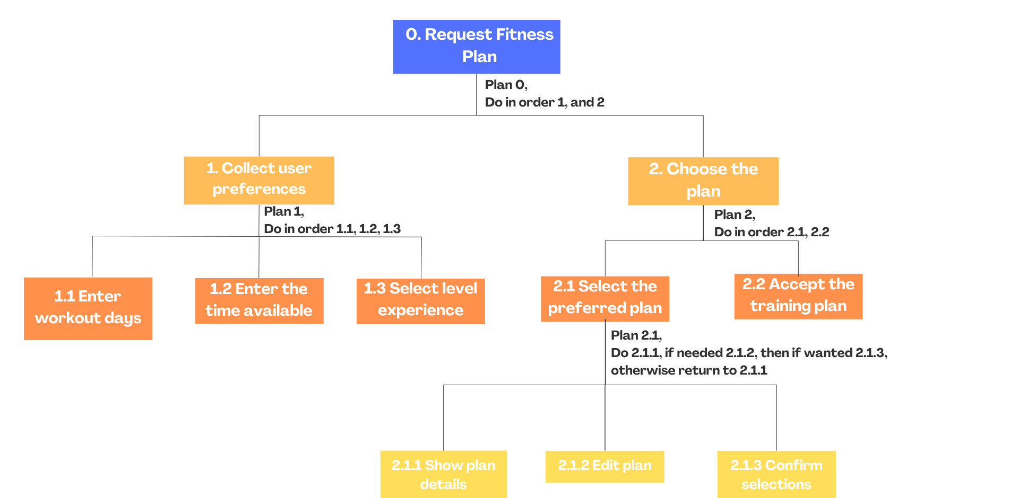
HTA : Request fitness plan
In order to perform the authentication to the application the user must enter in the app, if he or she is not registered must sign up inserting the needed information. After, the user can login of if he doesn’t remember the password, he or she can reset it.

Slide 29
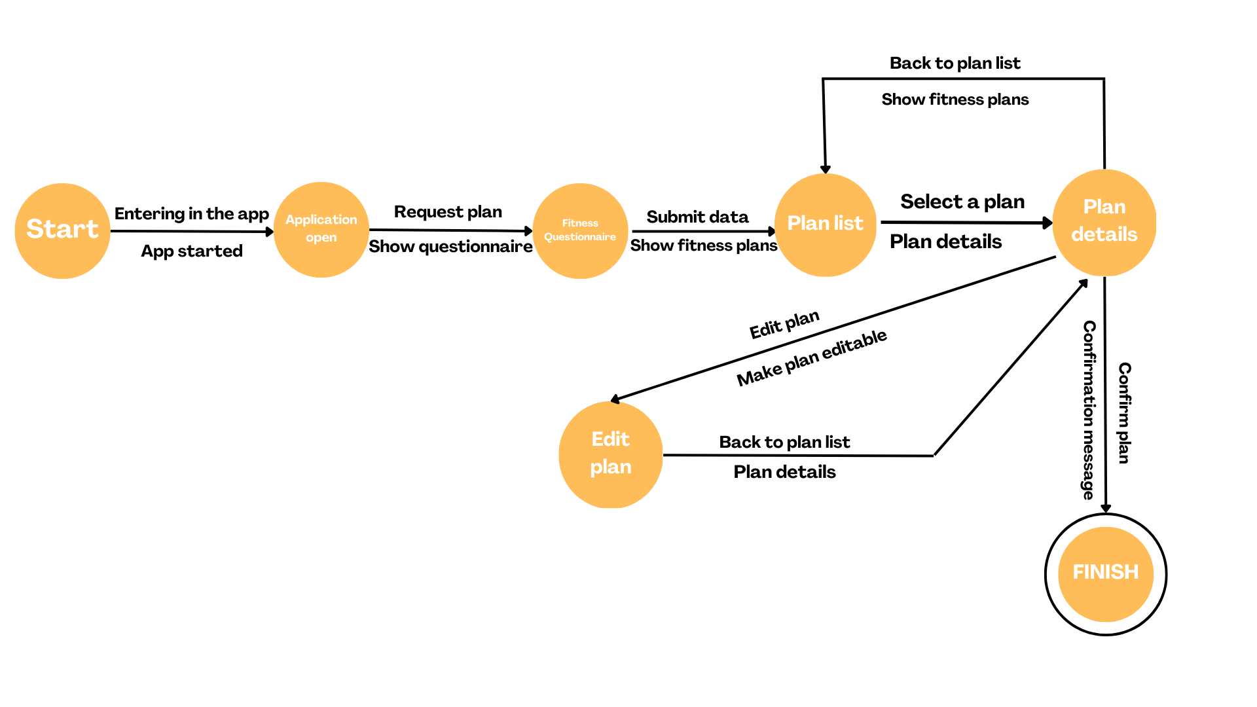
STN: Request fitness plan

Slide 30
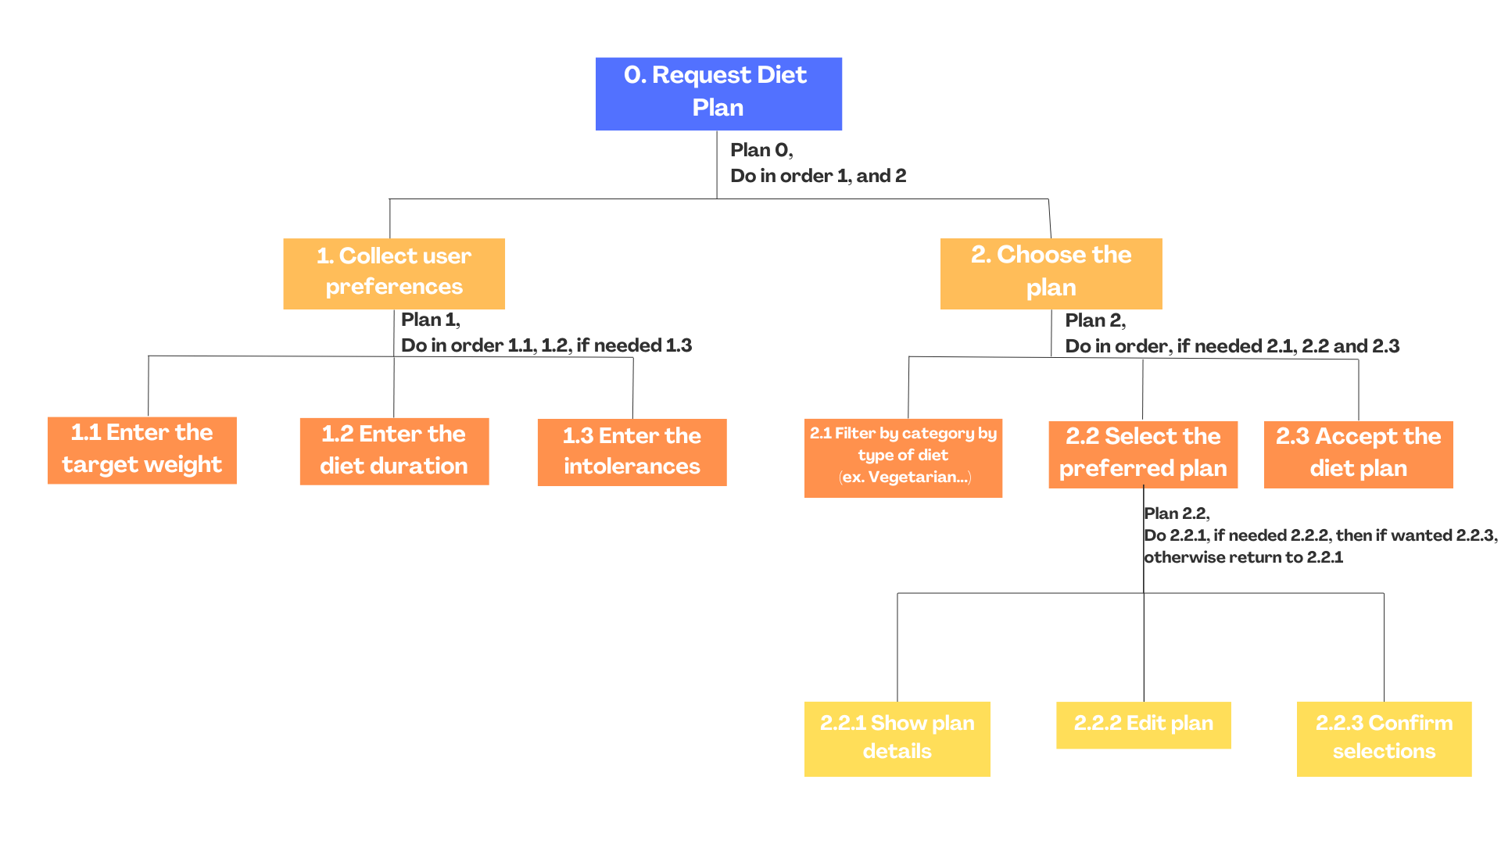
HTA : Request diet plan
In order to request a diet plan, the logged in user must fill out a form in which he or she will be asked about the target weight, the diet duration and food intolerances, if any. Then, the system will process the information and propose a set of choosable customized diet plans for the user.

Slide 31
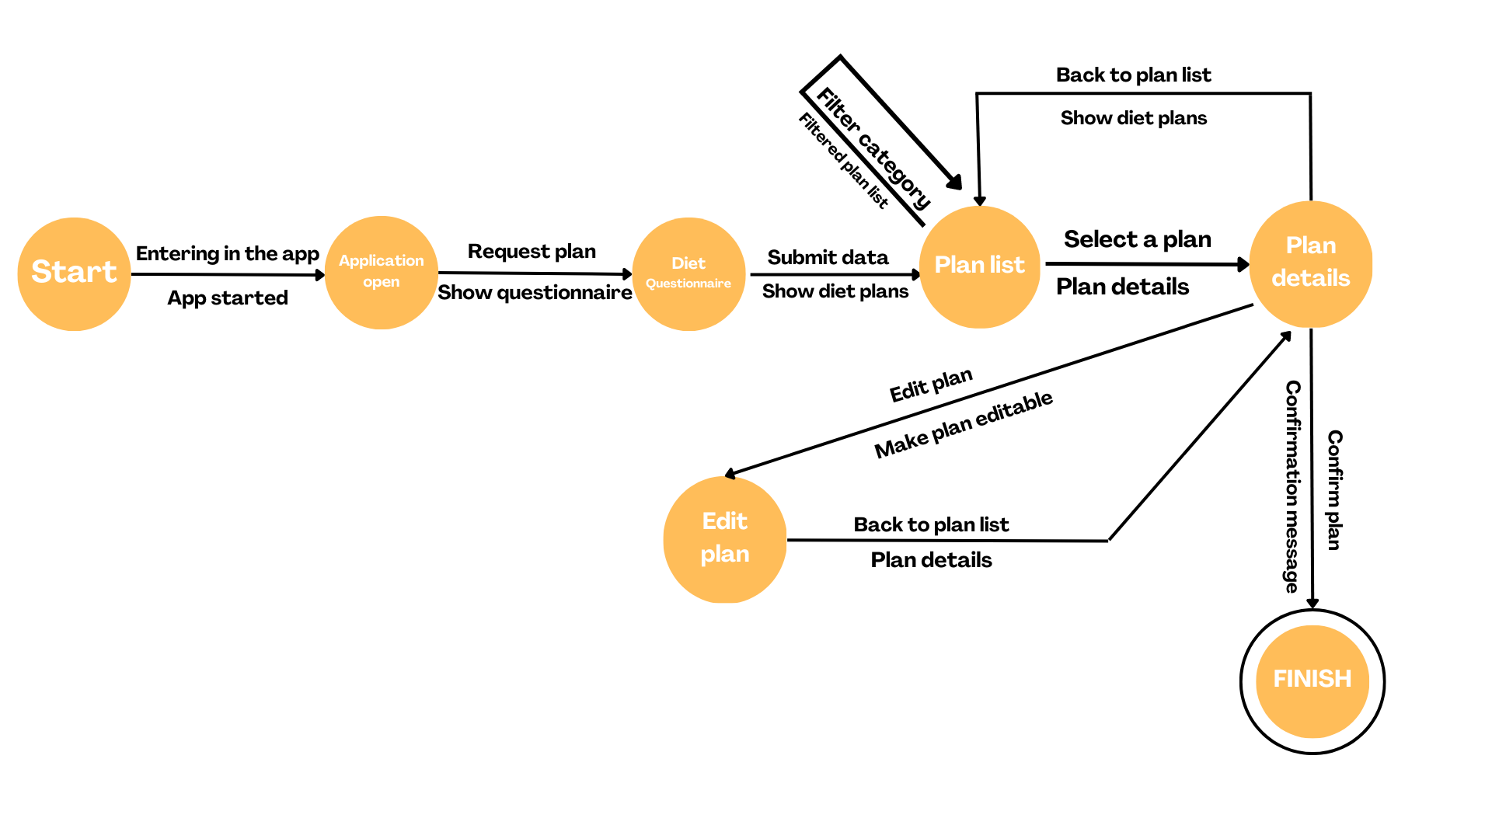
STN: Request diet plan

Slide 32
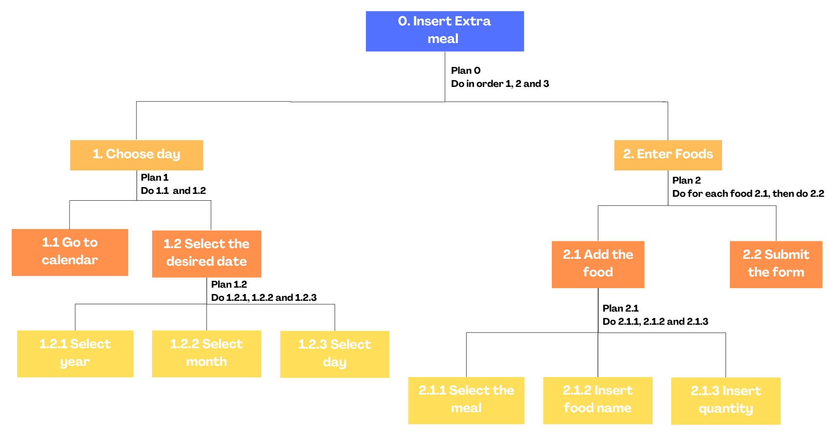
HTA : Insert extra meal
The logged in user, after going to the diet section, should first select the day on the calendar, then he can add the food by selecting the meal, inserting the eaten food name and quantity. Then can submit the form to the system. The application will have in its database the list of all foods with their nutritional values and will update the user's diet and workout plan accordingly to new needs.

Slide 33
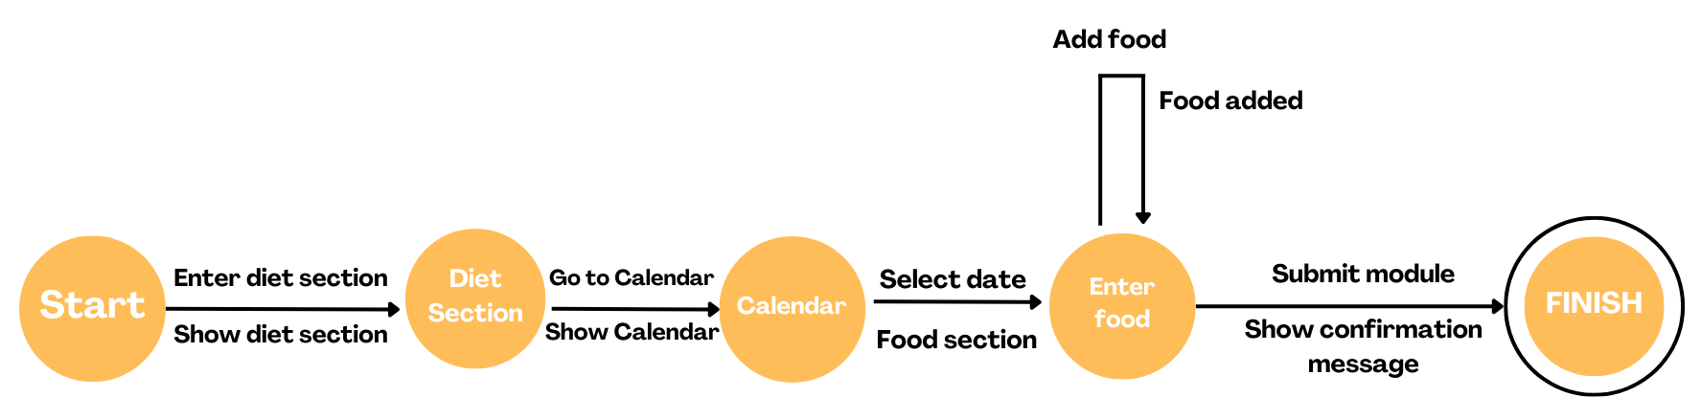
STN: Insert extra meal

Slide 34
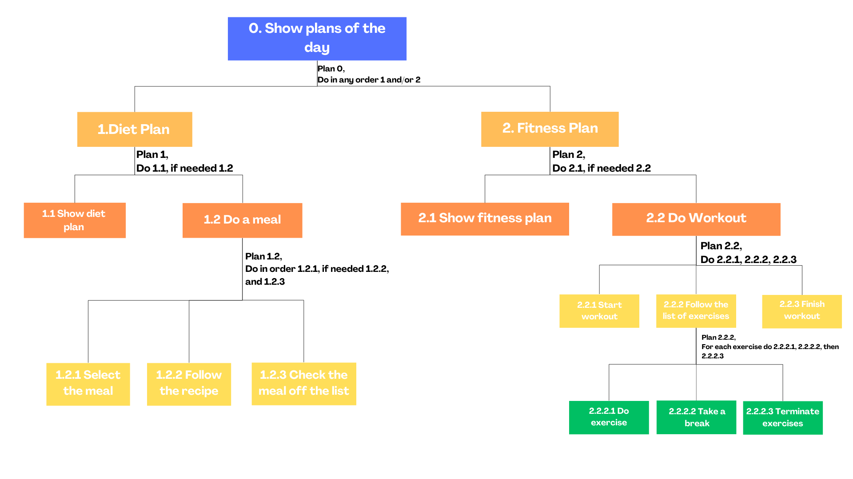
HTA : Show plans of the day
In order to show the plans of the day, the user, after going to the diet or fitness section he or she will be able to see the diet or the fitness plan. Then the user can start to do a meal, following the recipe or to workout, following the list of exercises, in which each exercise is composed of an exercise and a break.

Slide 35
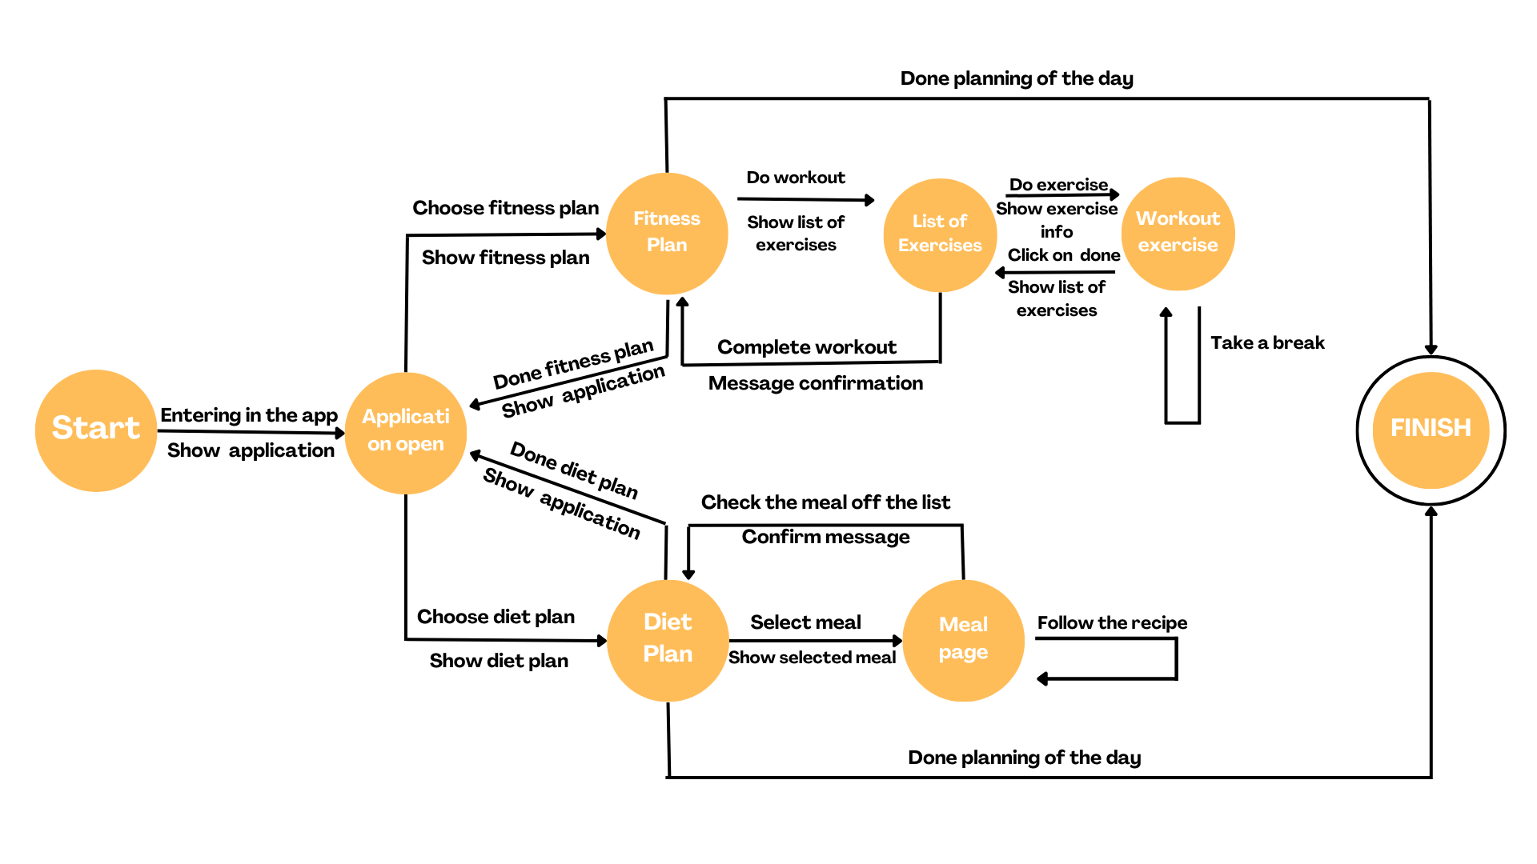
STN: Show plans of the day

Slide 36
STN: Show plans of the day

Slide 37
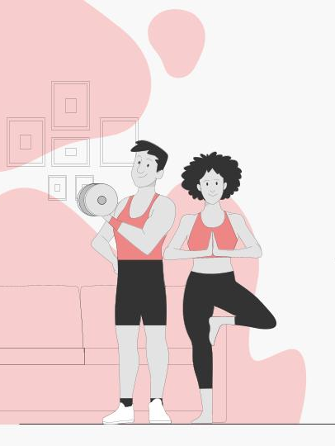
Prototype 1

Slide 38
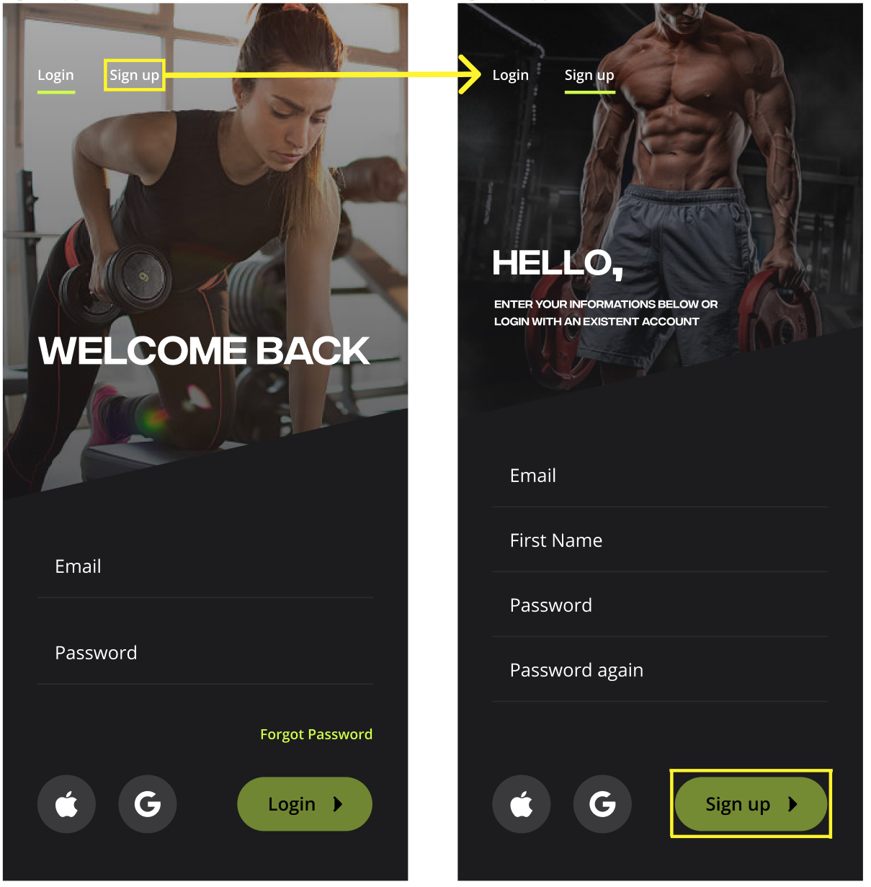
Main functionalities:
• Sign up: filling a form
• Login: with username and password
• Request Fitness Plan: filling a form and choose from the recommended plans, checking what each plan contains
• Request Diet Plan: filling a form and choose from the recommended plans, checking what each plan contains
• Insert Extra Meal: filling a form, the app will update the current diet plan based on the food entered (which is outside the planned diet)
• Show plans of the day: by navigating through the sections contained in the footbar, the user can choose to view the day's food plan and training plan.

Slide 39
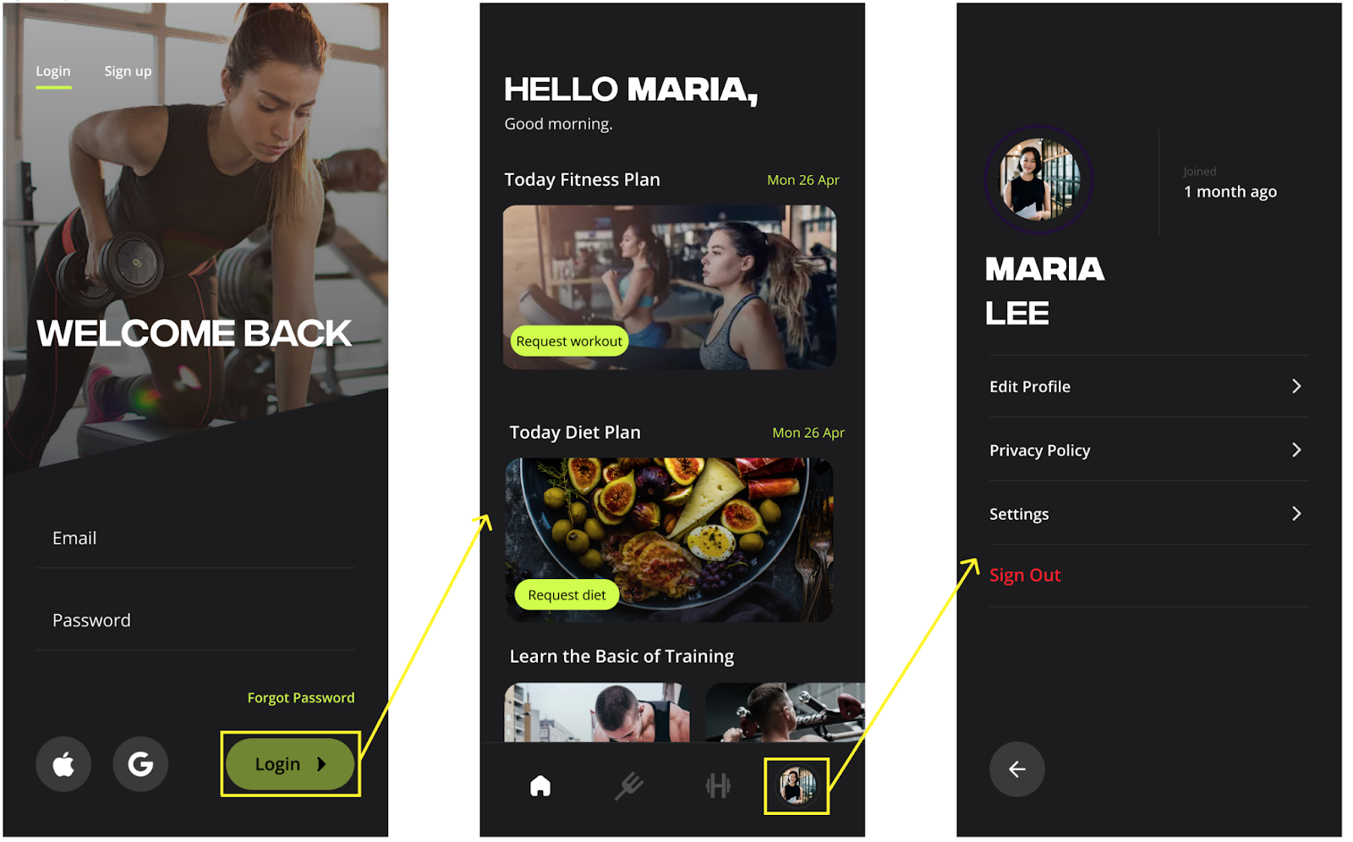
Main functionalities:
• Sign up: filling a form
• Login: with username and password
• Request Fitness Plan: filling a form and choose from the recommended plans, checking what each plan contains
• Request Diet Plan: filling a form and choose from the recommended plans, checking what each plan contains
• Insert Extra Meal: filling a form, the app will update the current diet plan based on the food entered (which is outside the planned diet)
• Show plans of the day: by navigating through the sections contained in the footbar, the user can choose to view the day's food plan and training plan.

Slide 40
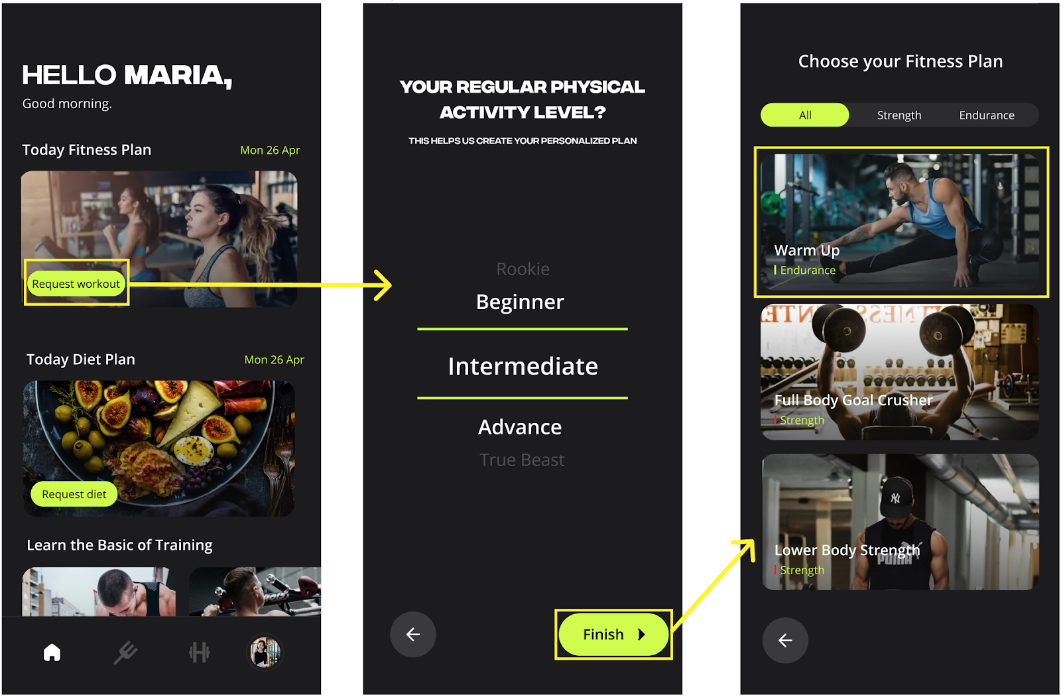
Main functionalities:
• Sign up: filling a form
• Login: with username and password
• Request Fitness Plan: filling a form and choose from the recommended plans, checking what each plan contains
• Request Diet Plan: filling a form and choose from the recommended plans, checking what each plan contains
• Insert Extra Meal: filling a form, the app will update the current diet plan based on the food entered (which is outside the planned diet)
• Show plans of the day: by navigating through the sections contained in the footbar, the user can choose to view the day's food plan and training plan.

Slide 41
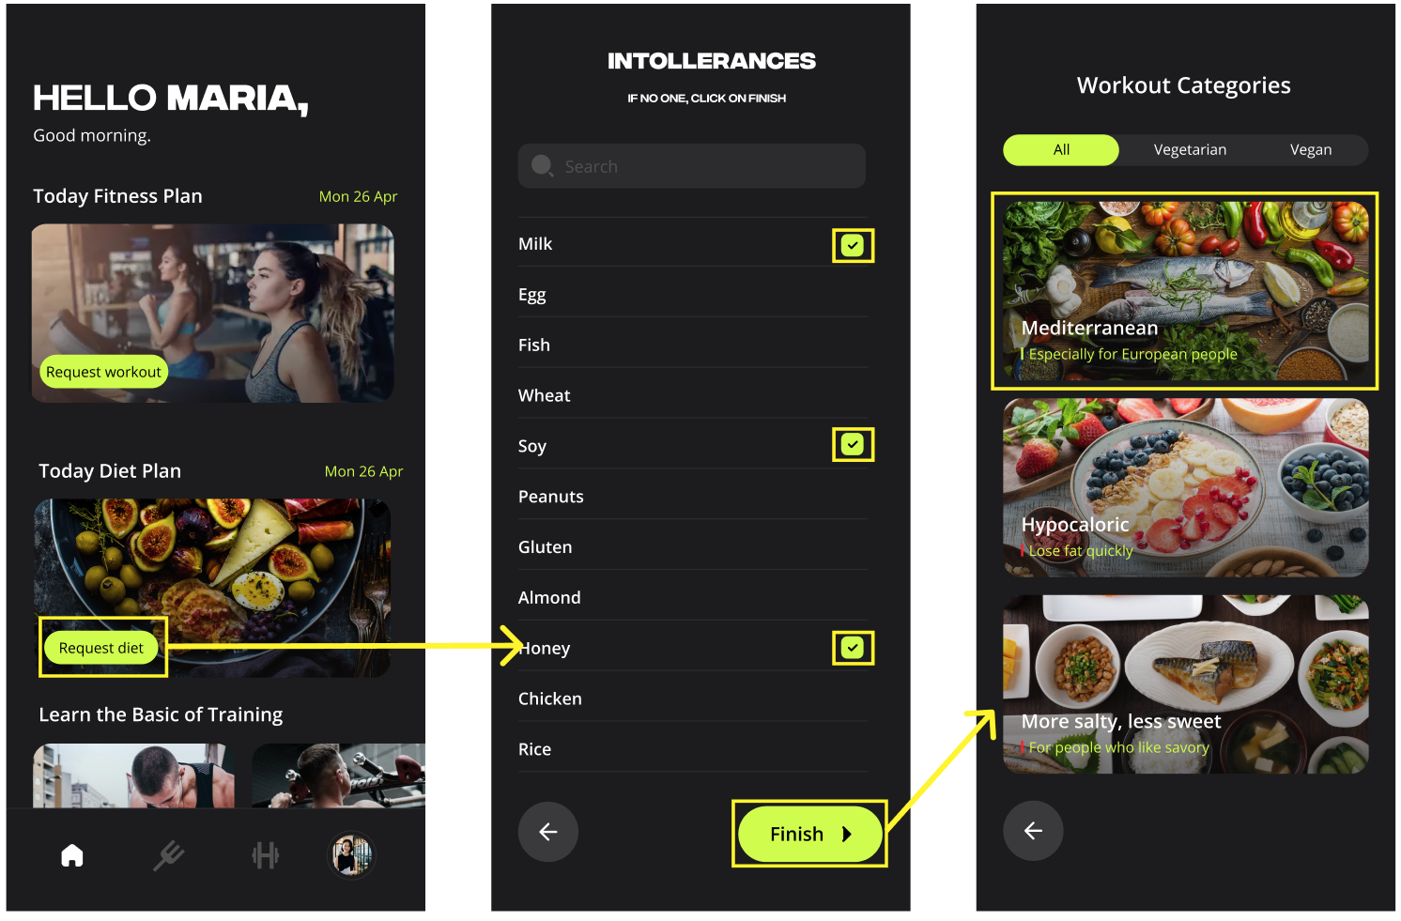
Main functionalities:
• Sign up: filling a form
• Login: with username and password
• Request Fitness Plan: filling a form and choose from the recommended plans, checking what each plan contains
• Request Diet Plan: filling a form and choose from the recommended plans, checking what each plan contains
• Insert Extra Meal: filling a form, the app will update the current diet plan based on the food entered (which is outside the planned diet)
• Show plans of the day: by navigating through the sections contained in the footbar, the user can choose to view the day's food plan and training plan.

Slide 42
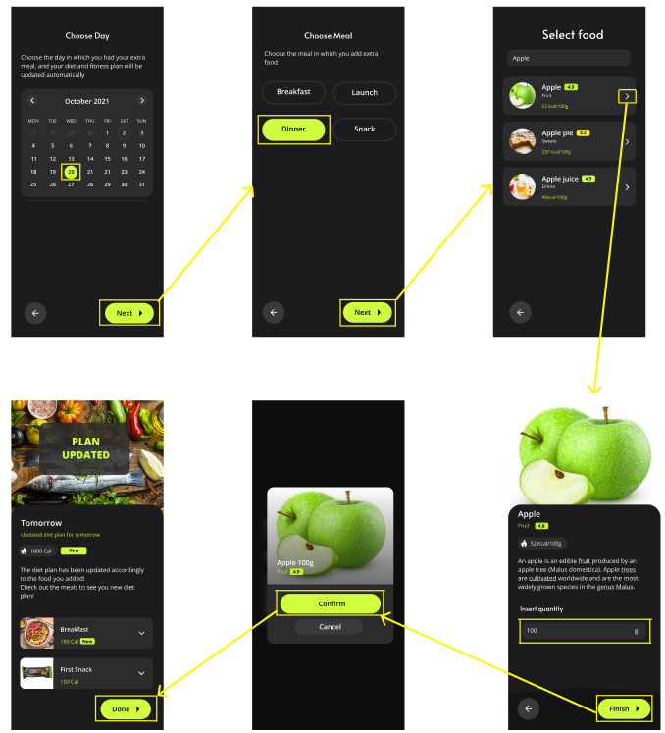
Main functionalities:
• Sign up: filling a form
• Login: with username and password
• Request Fitness Plan: filling a form and choose from the recommended plans, checking what each plan contains
• Request Diet Plan: filling a form and choose from the recommended plans, checking what each plan contains
• Insert Extra Meal: filling a form, the app will update the current diet plan based on the food entered (which is outside the planned diet)
• Show plans of the day: by navigating through the sections contained in the footbar, the user can choose to view the day's food plan and training plan.

Slide 43
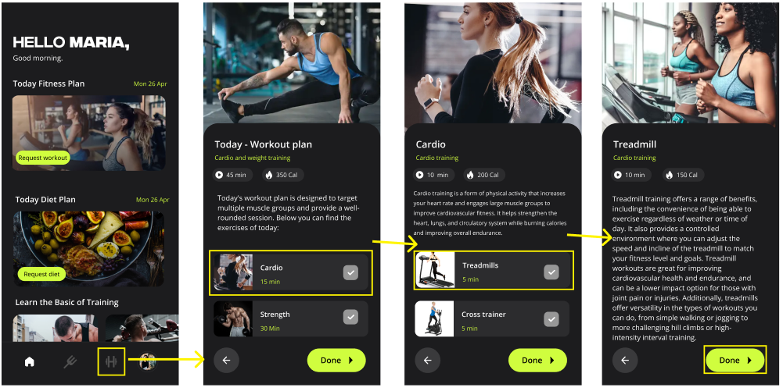
Main functionalities:
• Sign up: filling a form
• Login: with username and password
• Request Fitness Plan: filling a form and choose from the recommended plans, checking what each plan contains
• Request Diet Plan: filling a form and choose from the recommended plans, checking what each plan contains
• Insert Extra Meal: filling a form, the app will update the current diet plan based on the food entered (which is outside the planned diet)
• Show plans of the day: by navigating through the sections contained in the footbar, the user can choose to view the day's food plan and training plan.

Slide 44
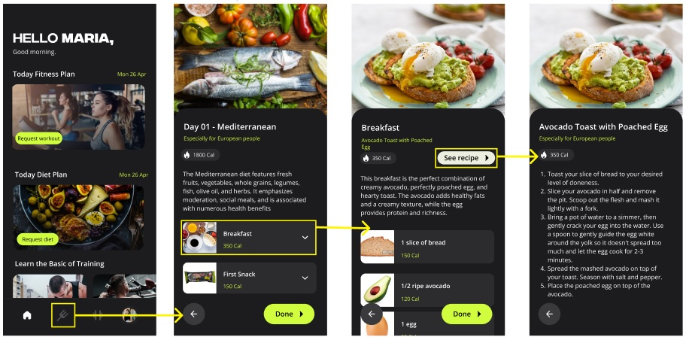
Main functionalities:
• Sign up: filling a form
• Login: with username and password
• Request Fitness Plan: filling a form and choose from the recommended plans, checking what each plan contains
• Request Diet Plan: filling a form and choose from the recommended plans, checking what each plan contains
• Insert Extra Meal: filling a form, the app will update the current diet plan based on the food entered (which is outside the planned diet)
• Show plans of the day: by navigating through the sections contained in the footbar, the user can choose to view the day's food plan and training plan.

Slide 45
Expert Based Evaluation

Slide 46
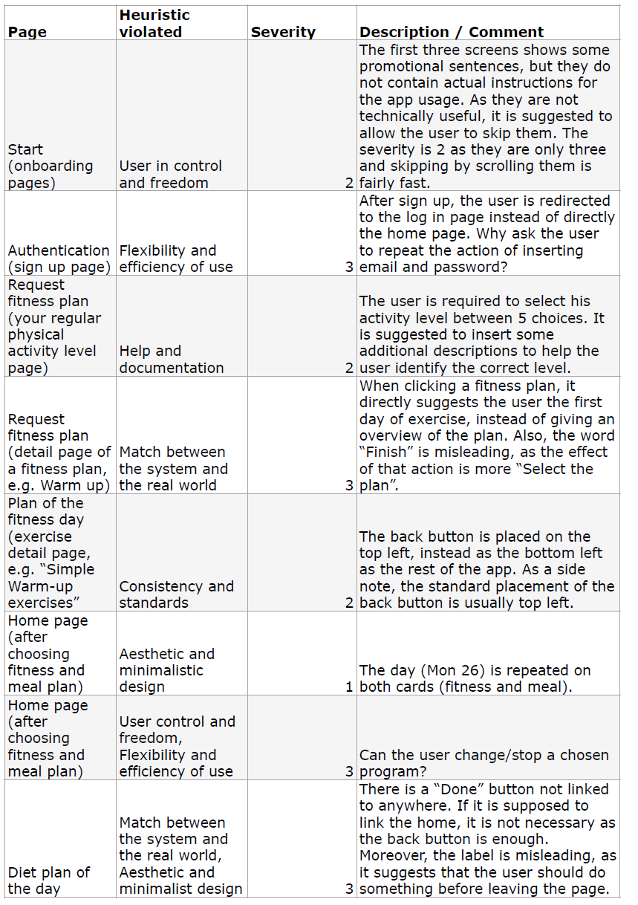
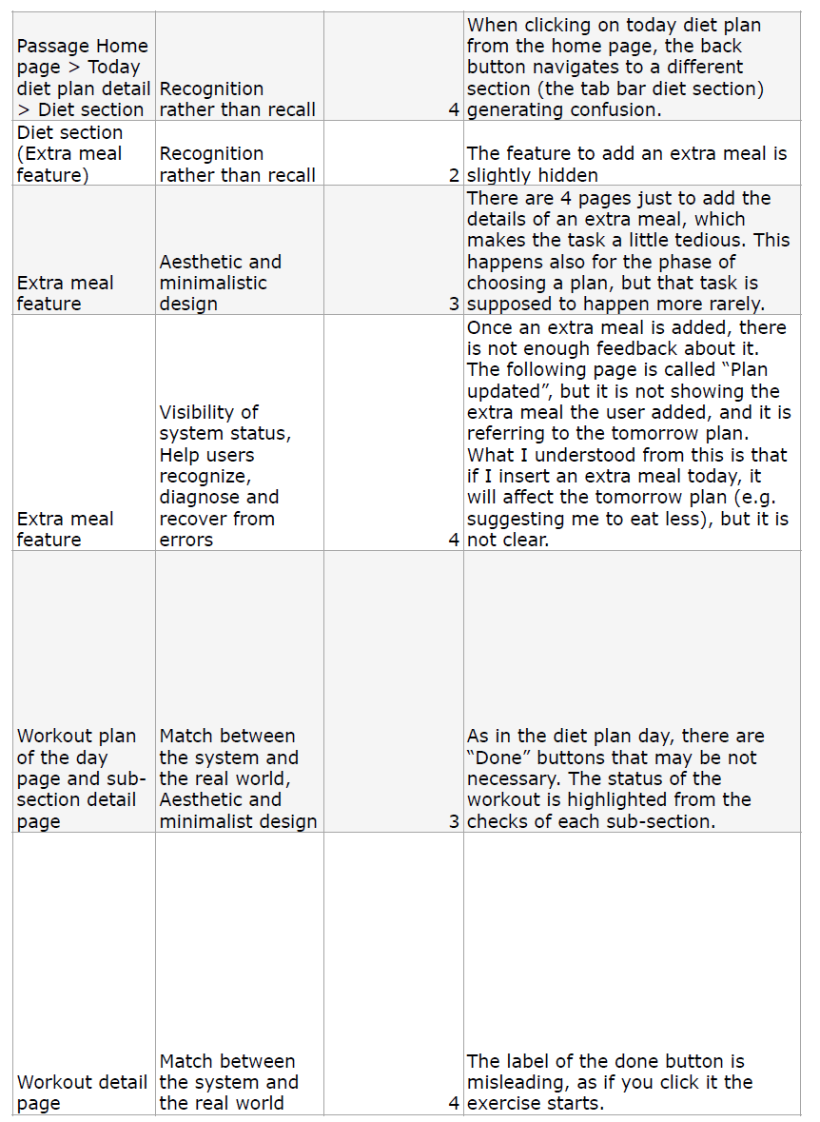
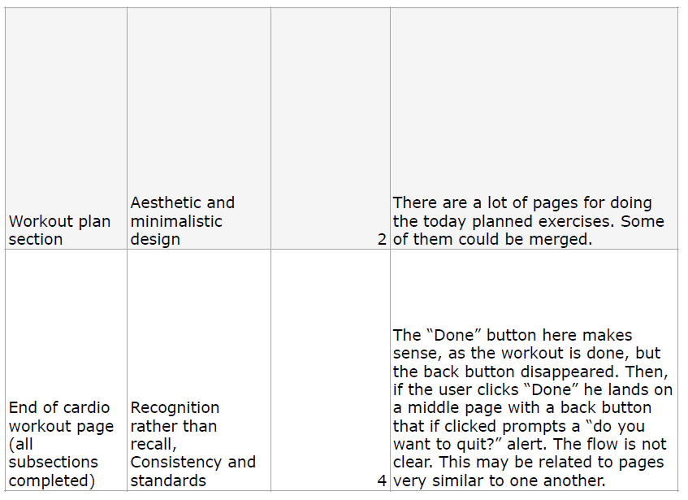
Heuristic Evaluation
Severity legend:
0: I don’t agree that this is a usability problem at all
1: Cosmetic problem only
2: Minor usability problem
3: Major usability problem
4: Usability catastrophe

Slide 47
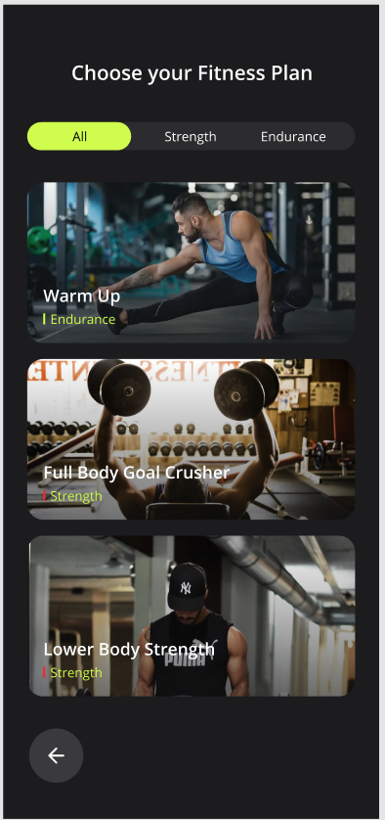
Cognitive Walkthrough
Task: Request a fitness plan.
Action 1: press button request workout.
Response 1: the system shows the first question about the number of days per week available for the training.
Action 2: select the number of days per week available for the training.
Response 2: the system shows the selected amount of days.
Action 3: press the “next” button.
Response 3: the system shows the next question about the time available for each workout.
Action 4: select the time available for each workout.
Response 4: the system shows the selected time.
Action 5: press the “next” button
Response 5: the system shows the next question about the workout level experience.
Action 6: select the workout level experience.
Response 6: the system shows the selected level experience.
Action 7: press the “Finish” button.
Response 7: the system shows a list of generated plans ad-hoc for the user.
Action 8: select the “endurance” type of workout on the filter.
Response 8: the system shows only the “endurance” type of workouts.
Action 9: press on the Warm Up Workout.
Response 9: the system shows an overview of the Warm Up Workout
Action 10: click on “Stability Training Basics” tab
Response 10: the system shows the video tutorial of the exercise
Action 11: Click on the back arrow button.
Response 11: the system shows the previous page.
Action 12: Click on the FInish button.
Response 12: the system shows a pop-up to confirm the choice.
Action 13: Click on the Confirm button.
Response 13: the system shows the home page updated with the selected plan.

Slide 48
Cognitive Walkthrough
Analysis guided by 4 predefined questions:
1. Is the effect of the action the same as the user’s goal at that point?
(Does the user understand that this subtask is needed to reach the goal?)
2. Will users see that the action is available?
3. Once user have found the correct action, will they know that it’s the one they need?
4. After the action is take, will users understand the feedback they get?
Expert’s corrections:
Action 1 - Q1: As the application provides multiple features, it is reasonable to expect the user to look for a dedicated page when aiming at requesting a fitness plan.
Action 1 - Q2: The button is visible and placed in a standard location, but the user could be misled by the label (why call it request a “workout”, if the (desired) effect is to request a fitness plan?)
Action 1 - Q3: The user could be misled by the label (workout instead of fitness plan). However, as there are only a few other actions available, it is reasonable to not doubt the correctness of this action.
We changed our prototypes to be compliant with the expert comments

Slide 49
Prototype 2

Slide 50
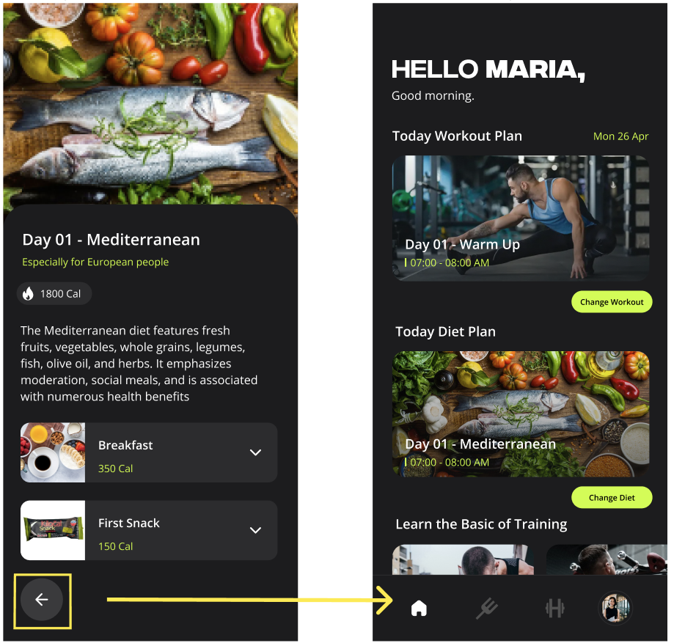
Correction of HE violations:
Frame: Diet section,
Heuristic Violated: Recognition rather than recall
Problem:
When clicking on today diet plan from the home page, the back button navigates to a different section (the tab bar diet section) generating confusion.
Solution:
The problem was solved by changing the previous redirect to the homepage.

Slide 51
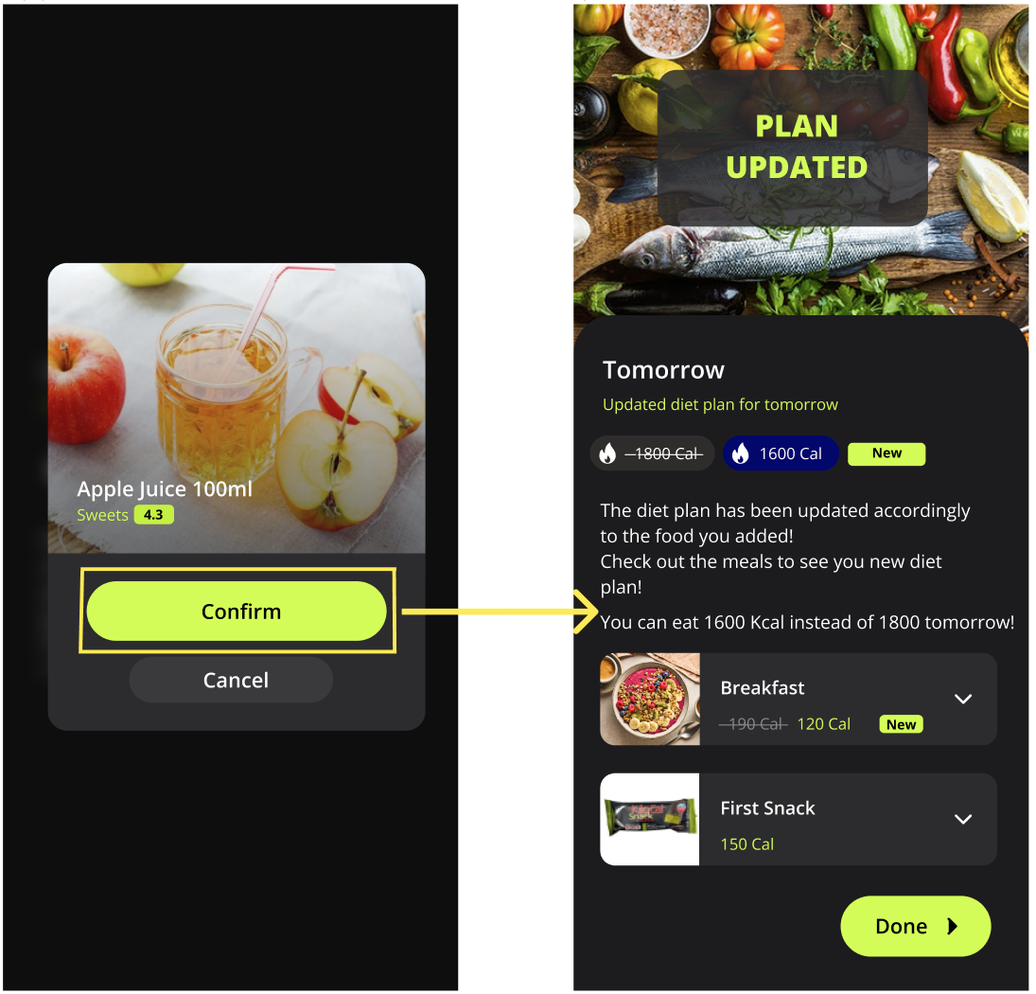
Correction of HE violations:
Frame: Extra meal feature,
Heuristic Violated: Visibility of system status, Help users recognize, diagnose and recover from errors
Problem:
Once an extra meal is added, there is not enough feedback about it. The following page is called “Plan updated”, but it is not showing the extra meal the user added, and it is referring to the tomorrow plan. What I understood from this is that if I insert an extra meal today, it will affect the tomorrow plan (e.g. suggesting me to eat less), but it is not clear.
Solution:
The problem has been solved by adding a button with crossed-out lettering that indicates the old amount of calories provided by the diet for the next day. Next to it, a new blue-colored button was inserted containing the new calorie amount updated according to the food entered. In addition, new details were added that let the user know that after the extra food was added, his or her diet was updated according to the food.

Slide 52
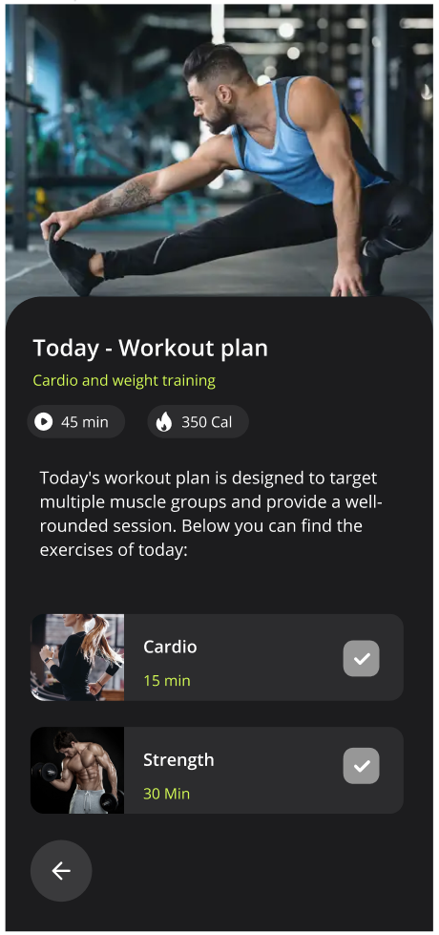
Correction of HE violations:
Frame: Workout detail page,
Heuristic Violated: Match between the system and the real world
Problem:
The label of the done button is misleading, as if you click it the exercise starts.
Solution:
The problem was solved by removing the "done" button from the page, as it led to misleading flow.

Slide 53
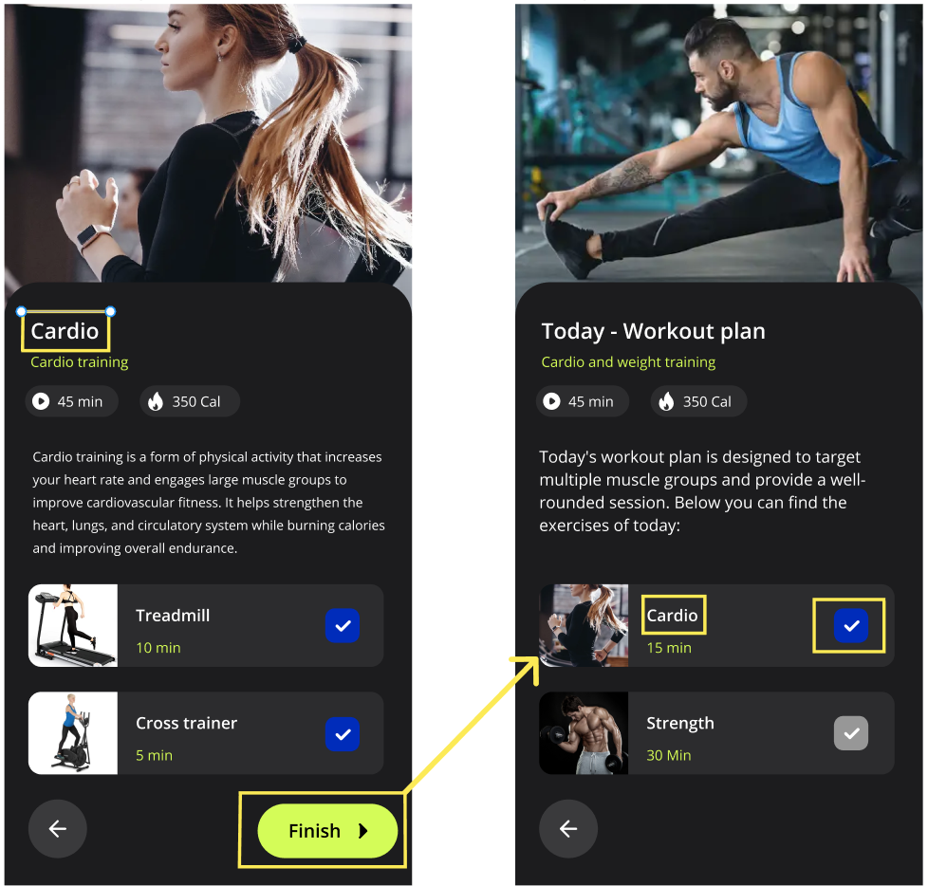
Correction of HE violations:
Frame: End of cardio workout page
Heuristic Violated: Recognition rather than recall, Consistency and standards
Problem:
The “Done” button here makes sense, as the workout is done, but the back button disappeared. Then, if the user clicks “Done” he lands on a middle page with a back button that if clicked prompts a “do you want to quit?” alert. The flow is not clear. This may be related to pages very similar to one another.
Solution:
The problem was solved by inserting a "finish" button that, when clicked, returns the user to the full training plan and marks the relevant subcategory of exercises as completed. Also, the flow that results from clicking the button to return to the previous page has been corrected.

Slide 54
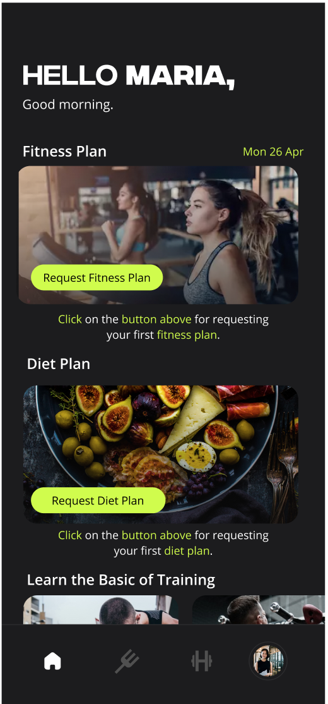
Correction of Cognitive Walkthrough:
Task: Request a fitness plan.
From the CW expert's evaluation, it emerged how there are some labels that can be misunderstood. In addition, we improved the user's perception of the homepage:
all labels that included the word "workout" were changed to the words "fitness plan".
two phrases have been added to the homepage that indicate exactly where the user should click to request a fitness plan or diet plan.

Slide 55

Think Aloud

Slide 56
Think Aloud Session
Users:
Both young people, from 18-30 years, which were our colleagues or housemates, and also with people in the range 40-55 which were our relatives. All the people presented the characteristics described in our user profile.
Each user has to accomplish the following tasks individually:
– Request a fitness plan
– Request a diet plan
– Insert an extra meal
– See the details of the “today” diet plan
– See the details of the “today” fitness plan
How:
Each person had his own smartphone and performed the task on the interactive prototype 2.
Each user talked aloud about what he was doing and what he is not understanding

Slide 57
Think Aloud Session: Results
All the users really liked the interface and the features of the app, in particular the possibility to add a meal which was not scheduled by your plan, and the fact that the plan is updated automatically.
Problems:
Request fitness/diet plan button
Almost all users thought that was possible to create the plan by clicking on the image box.
So we decided to remove the yellow button and make the entire image box clickable.
Entering diet/fitness section for the first time
Some people seemed to be really confused by the fact that the first time the user tries to enter the fitness section or diet section, he is sent to the questionnaire to create a fitness plan or a diet plan instead that to the diet/fitness section.
The solution is to send users to the diet section or fitness section, showing an image box to create the plan for the first time.
Your health status chart
Almost the majority of the users expected the image box “Your health status” in the fitness section to be clickable.
So we decided to make the button clickable showing the chart in detail.

Slide 58
Controlled Experiment

Slide 59
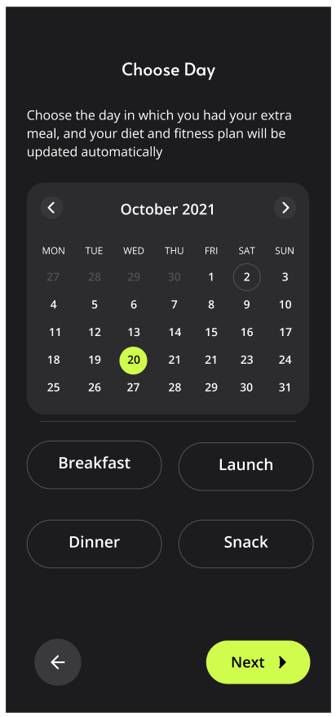
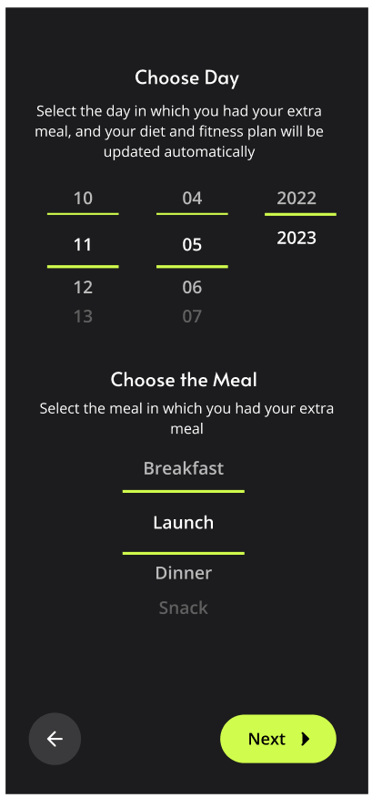
#1 - Insert Extra Meal
In the prototype we implemented the "Insert Extra Meal" interface with a calendar for choose the dat and buttons for select the meal. (left figure)
Since we were not sure that the user would find the day desired in an immediate way interacting with the calendar, we decided to run a controlled experiment to understand if the use of sliders would have made the task easier and faster to execute. (right figure).
The controlled experiment has been performed with ANOVA One-Way analysis. We asked to 16 different people to perform the task, divided in two groups of 8 people.

Slide 60
Controlled Experiment for FitMatch
Who?
we searched for people according to our user profile (14-50 y), also relying on the data collected through the questionnaire.
Variables:
Independent: the two interfaces:
Interface 1: Choose day with a calendar and buttons for meal.
Interface 2: Choose day and meal with sliders
Dependent: the time in seconds to execute a task.
Hypothesis:
Null: no differences between two interfaces;
Our: users will complete the task in less time using the interface with sliders (interface 2).
Experiment:
Task: "Insert Extra Meal";
Assumptions: user is already logged and is on the diet page.
Apply ANOVA: We measured how much time each user takes to perform the same task requested with the two different interfaces using a chronometer.

Slide 61
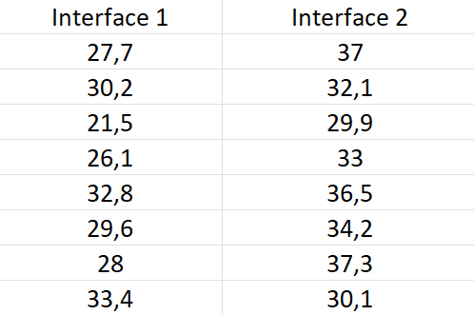
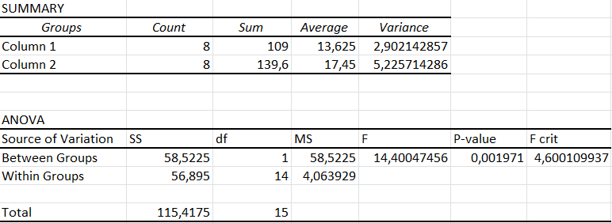
ANOVA RESULTS - 1
F > F-crit and so the null hypothesis, that say that there are no differences between the interfaces, can be rejected.
The two examined populations (the groups of data collected using interface 1, and the other using interface 2) are not equal.
Threshold used for significance level: 0.05. P-value: 0.001971 < 0.05
The means: 13,625 < 17,45
Mean Interface 1 < Mean Interface 2.
Initial hypothesis disapproved: Interface 1, has better performances compared to the interface 2, so we keep interface 1.

Slide 62
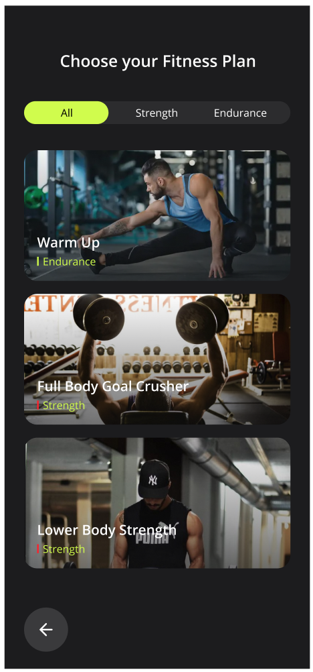

#2 - Request Fitness Plan
In the prototype we implemented the "Request Fitness Plan" interface with a filter for the various plans categories.
(left figure)
We wondered whether it would be faster and more intuitive if the user scrolled through the plans to choose his or her favorite or filtered the plans by a criteria and then chose the plan. (right figure).
The controlled experiment has been performed with ANOVA One-Way analysis. We asked to 16 different people to perform the task, divided in two groups of 8 people.

Slide 63
Controlled Experiment for FitMatch
Who?
we searched for people according to our user profile (14-50 y), also relying on the data collected through the questionnaire.
Variables:
Independent: the two interfaces:
Interface 1: Choose the plan filtering filtering by category through 3 buttons.
Interface 2: Choose the plan scrolling the screen.
Dependent: the time in seconds to execute a task.
Hypothesis:
Null: no differences between two interfaces;
Our: users will complete the task in less time scrolling the screen. (interface 2).
Experiment:
Task: "Request Fitness Plan”;
Assumptions: user is already logged and is on the Homepage.
Apply ANOVA: We measured how much time each user takes to perform the same task requested with the two different interfaces using a chronometer.

Slide 64

ANOVA RESULTS - 2
F > F-crit and so the null hypothesis, that say that there are no differences between the interfaces, can be rejected.
The two examined populations (the groups of data collected using interface 1, and the other using interface 2) are not equal.
Threshold used for significance level: 0.05. P-value: 0.010005338 < 0.05
The means: 28,6625 < 33,7625
Mean Interface 1 < Mean Interface 2.
Initial hypothesis disapproved: Interface 1, has better performances compared to the interface 2, so we keep interface 1.

Slide 65
Final Product:
Fit Match
Andrea Panceri, Francesco Sudoso, Pietro Lamanna

Slide 66

Technological Information:

Slide 67

Product Storyboard: Introduction

Slide 68

Product Storyboard: Authentication

Slide 69

Product Storyboard: Homepage

Slide 70

Product Storyboard: Request fitness plan

Slide 71

Product Storyboard: Request diet plan

Slide 72

Product Storyboard: Insert extra meal

Slide 73

Product Storyboard: Show today’s fitness plan

Slide 74

Product Storyboard: Show today’s diet plan

Slide 75

Product Storyboard: Show recipe details

Slide 76

Product Storyboard: Account

Slide 77

Product Storyboard: App settings and contact us

Slide 78
Thanks for the attention
Andrea Panceri, Francesco Sudoso e Pietro Lamanna

